Slide 1
Phase 3 Test Report

Slide 2
测试内容
Bandwidth=100MHz
Fc=3.5GHz
SV Sim vs VXT-II test result
SISO | Cable Test |  | OTA Test
Tx (100MHz) | EVM ACLR SEM 单个RFImp的测量 组合RFImp的测量 |  | EVM ACLR SEM Ideal情况的测量 组合RFImp的测量
Rx (100MHz) | Sensitivity(wide range) | EVM Throughput 单个RFImp的测量 组合RFImp的测量 | EVM Throughput Ideal情况的测量 组合RFImp的测量
 | Narrow Blocking
 | General Blocking
 | Intermodulation
PA_TOI
DAC_Nbits
Gain Imbalance
IQ offset
Phase Noise
Noise Figure
ADC_Nbits
Gain Imbalance
IQ offset
Phase Noise

Slide 3
SV结合VXT-II 发射端指标测试验证流程图
SV产生5G NR基站 SISO理想基带信号
带入Tx射频器件非理想因素
下载到VXT-||原型机
OTA需带入用户天线
OTA需要经过暗室
OTA测试需经过暗室接收天线
VXT-|| 原型机收端接收
VSA将信号送回到SystemVue
测量基站发射端指标
带入Tx射频非理想因素
Phase Noise
Oscillator
Oscillator
5G NR基站 SISO Ideal Signal
DAC
Modulator
filter
Mixer
Amplifier
DAC_Nbits
IQ offset
Gain Imbalance
PA_TOIout

Slide 4
纯软件仿真发射端流程图
SV产生5G NR基站 SISO理想基带信号
带入Tx射频器件非理想因素
带入VXT-|| Tx系统级参数
OTA需带入用户发射天线模型
OTA需要经过OTA模型
OTA需带入暗室接收天线模型
带入VXT-|| Rx系统级参数
仿真基站发射指标
带入系统参数仿真
VXT-II Phase Noise
Oscillator
5G NR基站 SISO Imp Signal
Modulator
Density
A to D
OTA
Gain
VXT-II IQ offset
VXT-II Gain Imbalance
天线方向图
Chamber Pathloss
VXT-II Noise Density
VXT-II ADC_Nbits

Slide 5
SV结合VXT-II 接收端指标测试验证流程图
SV产生5G NR基站 SISO理想基带信号
带入Rx射频器件非理想因素
下载到VXT-||原型机
OTA测试需带入暗室发射天线
OTA测试需要经过暗室
OTA测试需经过用户接收天线
VXT-|| 原型机收端接收
VSA将信号送回到SystemVue
测量基站接收端指标
带入Rx射频非理想因素
Phase Noise
Oscillator
Oscillator
5G NR基站 SISO Ideal Signal
Modulator
Noise Density
Amplifier
Mixer
Demod
ADC
174dBm/Hz
Noise Figure
Gain Imbalance
IQ offset
ADC_Nbits

Slide 6
纯软件仿真接收端流程图
SV产生5G NR基站 SISO理想基带信号
带入Rx射频器件非理想因素
带入VXT-|| Tx系统级参数
OTA需带入暗室发射天线模型
OTA需要经过OTA模型
OTA需带入用户接收天线模型
带入VXT-|| Rx系统级参数
仿真基站发射指标
带入系统参数仿真
VXT-II Phase Noise
Oscillator
5G NR基站 SISO Imp Signal
Modulator
Density
Demod
A to D
OTA
Gain
天线方向图
Chamber Pathloss
VXT-II
Ndensity
VXT-II Gain Imbalance
VXT-II IQ offset
VXT-II ADC_Nbits

Slide 7
NR DL SISO Tx EVM/ACLR vs PA_TOI
NR DL 100MHz SV Sim vs VXT-II Test
RF Imp | EVM(dB) |  |  | 1BW_Upper_ACLR(dB) |  |  | 1BW_Lower_ACLR(dB)
PA_TOI (dBm) | VXT | Sim | Delta | VXT | Sim | Delta | VXT | Sim | Delta
30 | -48.458 | -49.843 | 1.385 | 53.743 | 53.563 | 0.18 | 53.926 | 53.579 | 0.347
20 | -37.54 | -37.974 | 0.434 | 43.945 | 44.369 | 0.424 | 44.108 | 44.426 | 0.318
15 | -27.581 | -27.651 | 0.07 | 34.283 | 34.43 | 0.147 | 34.456 | 34.501 | 0.045
VXT-II NR Tx Cable Test Parameters
Power(dBm) | Ndensity(dBm/Hz) | DAC_Nbits(Bits) | Gain Imbalance(dB) | IQ Offset (dB) | Phase Noise(dBc/Hz)
0 | -133.9 | 14 | 0.002 | 0.0044 | [100, -97.133, 1000, -106.072, 1e4, -118.607]

Slide 8
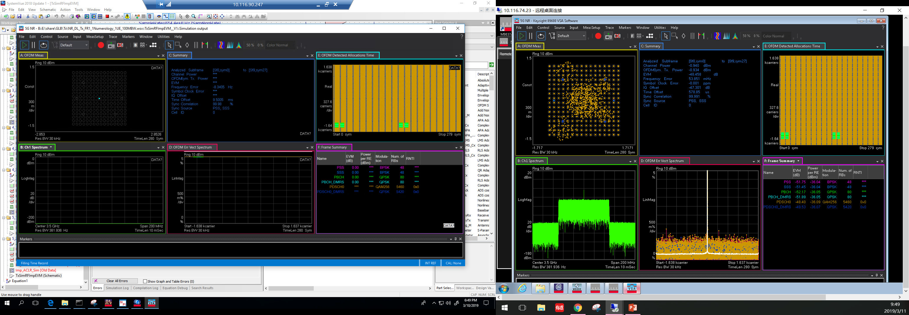
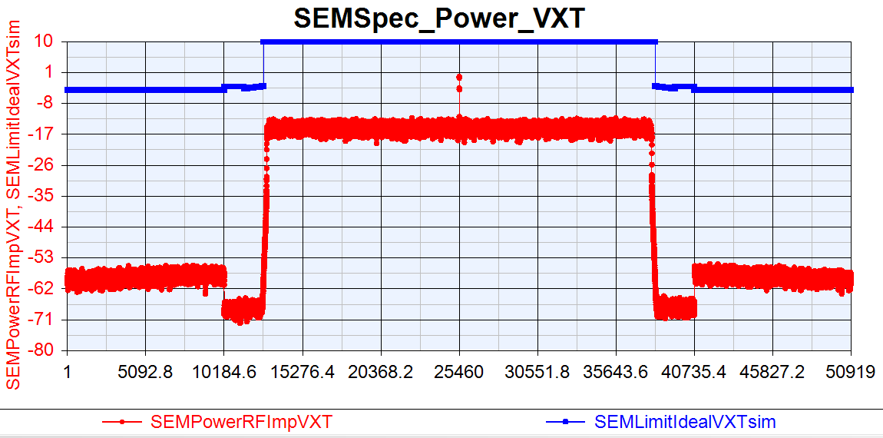
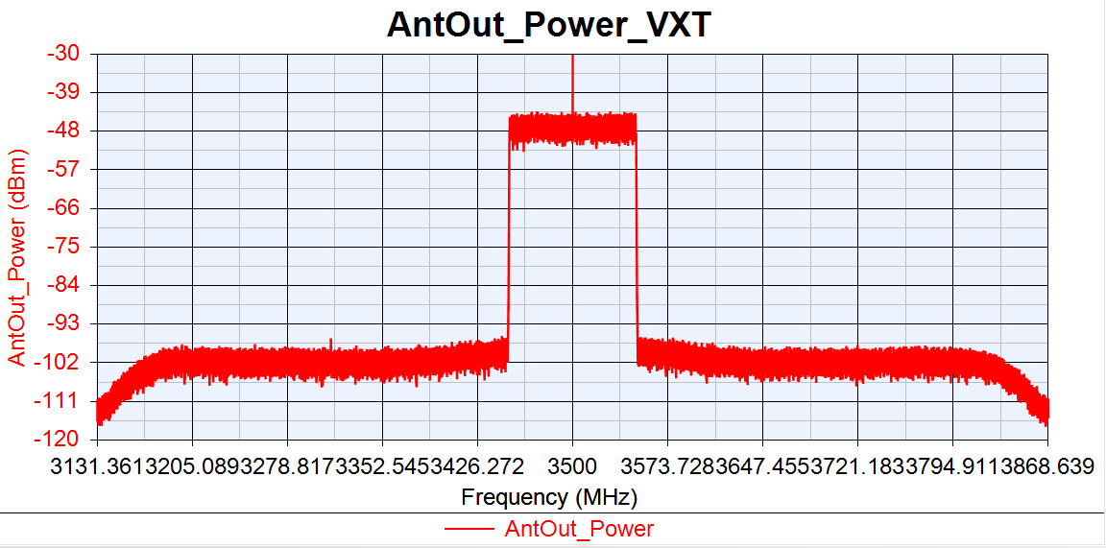
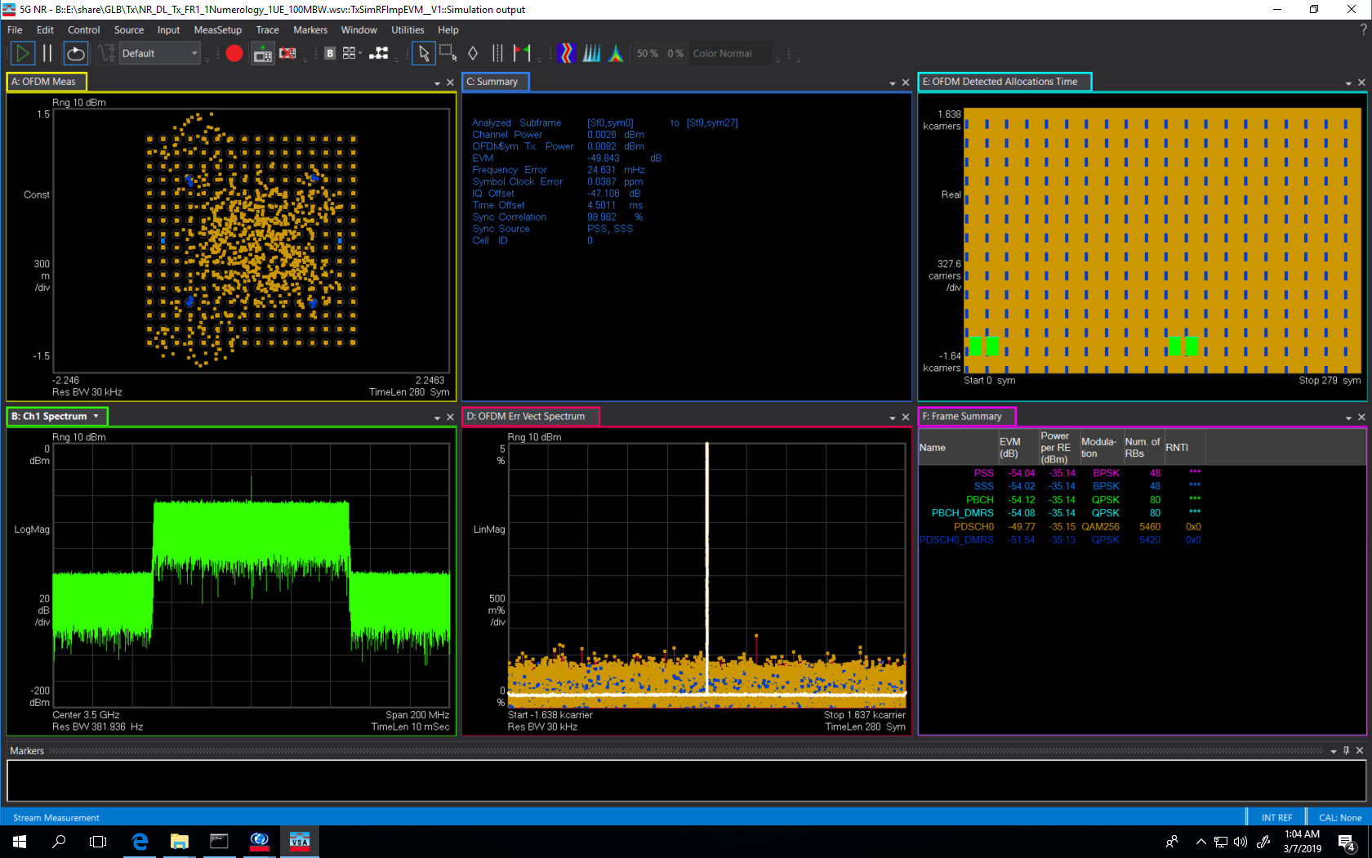

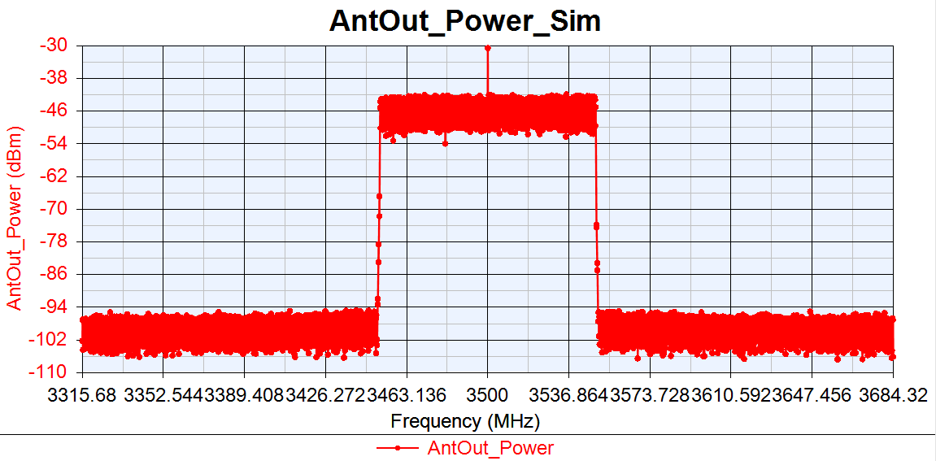
VXT-II vs SV Sim: PA_TOI=30dBm
NR DL 100MBW Tx Cable
VXT-II
EVM:-48.458dB
IQoffset:-47.301dB
EVM:-49.843dB
IQoffset:-47.106dB
Sim

Slide 9
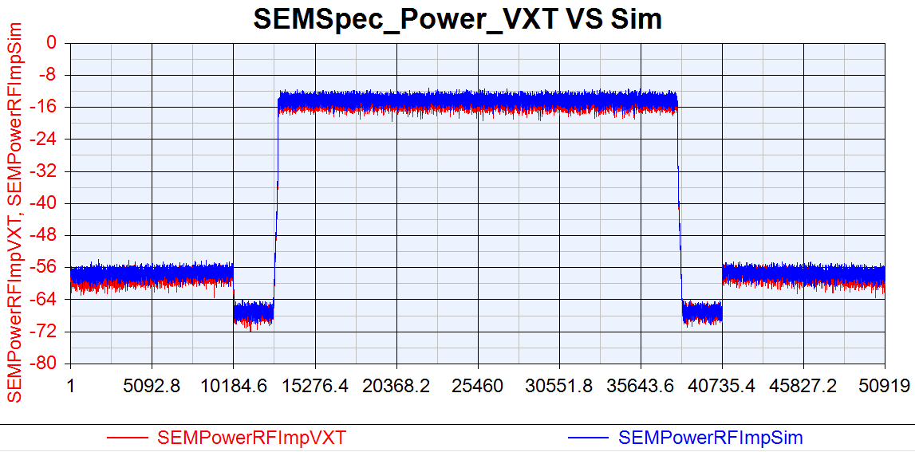
VXT SEM VS Sim SEM: PA_TOI=30dBm
NR DL 100MBW Tx Cable

Slide 10
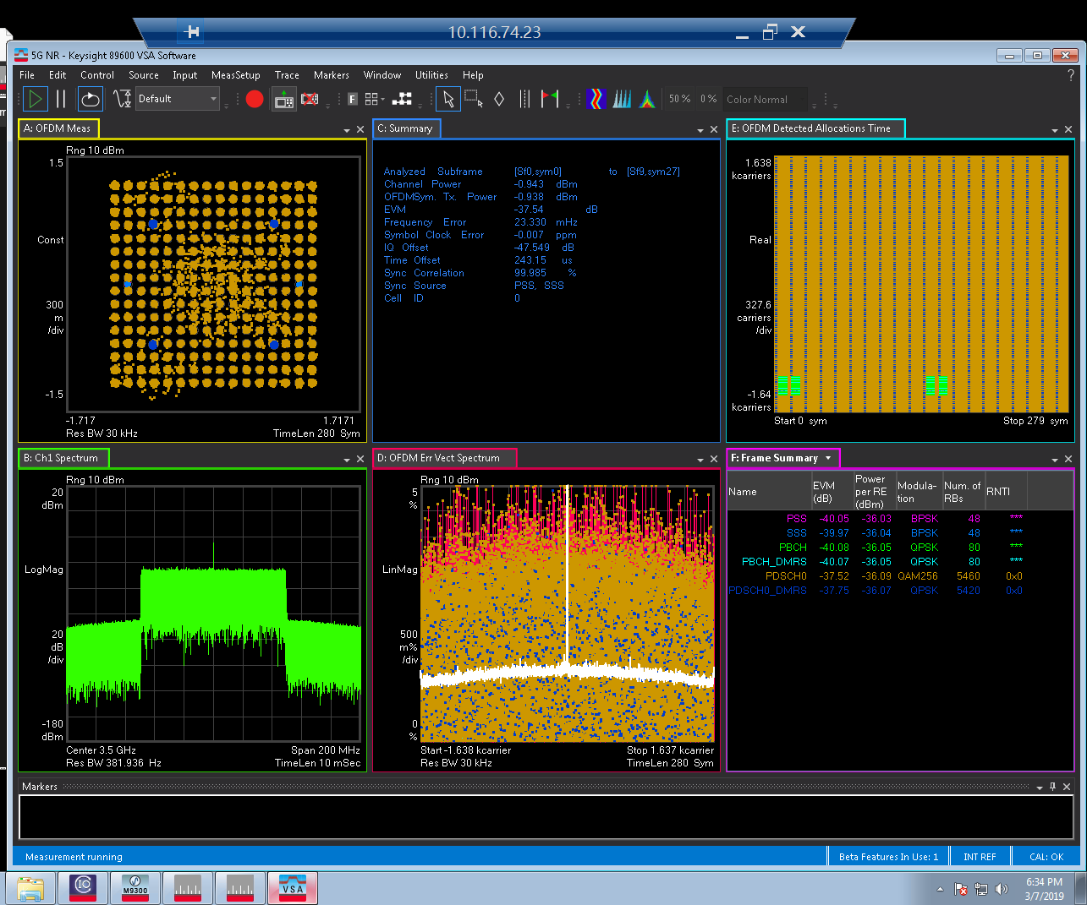
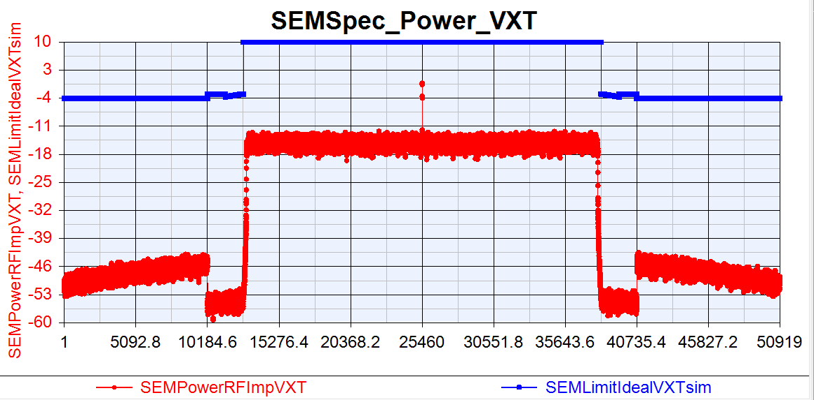
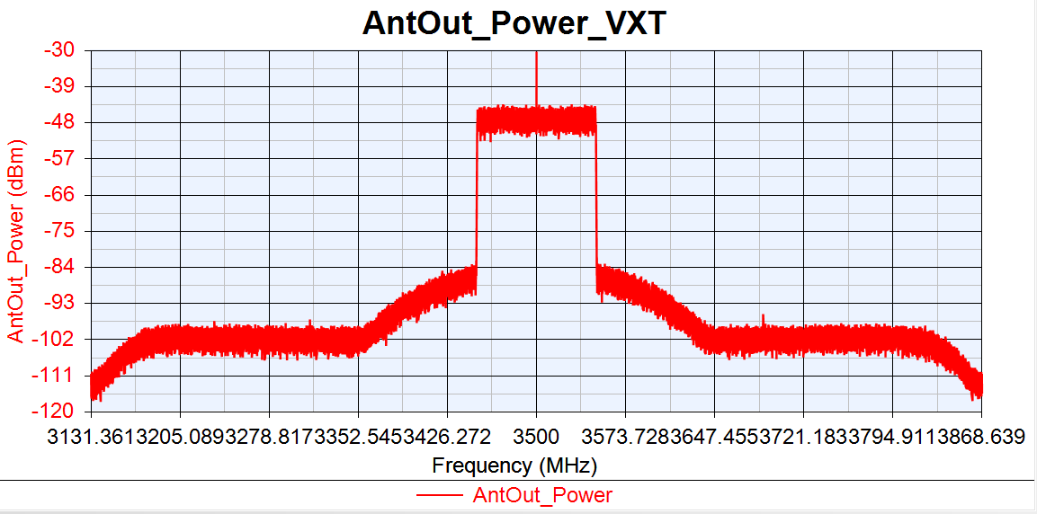
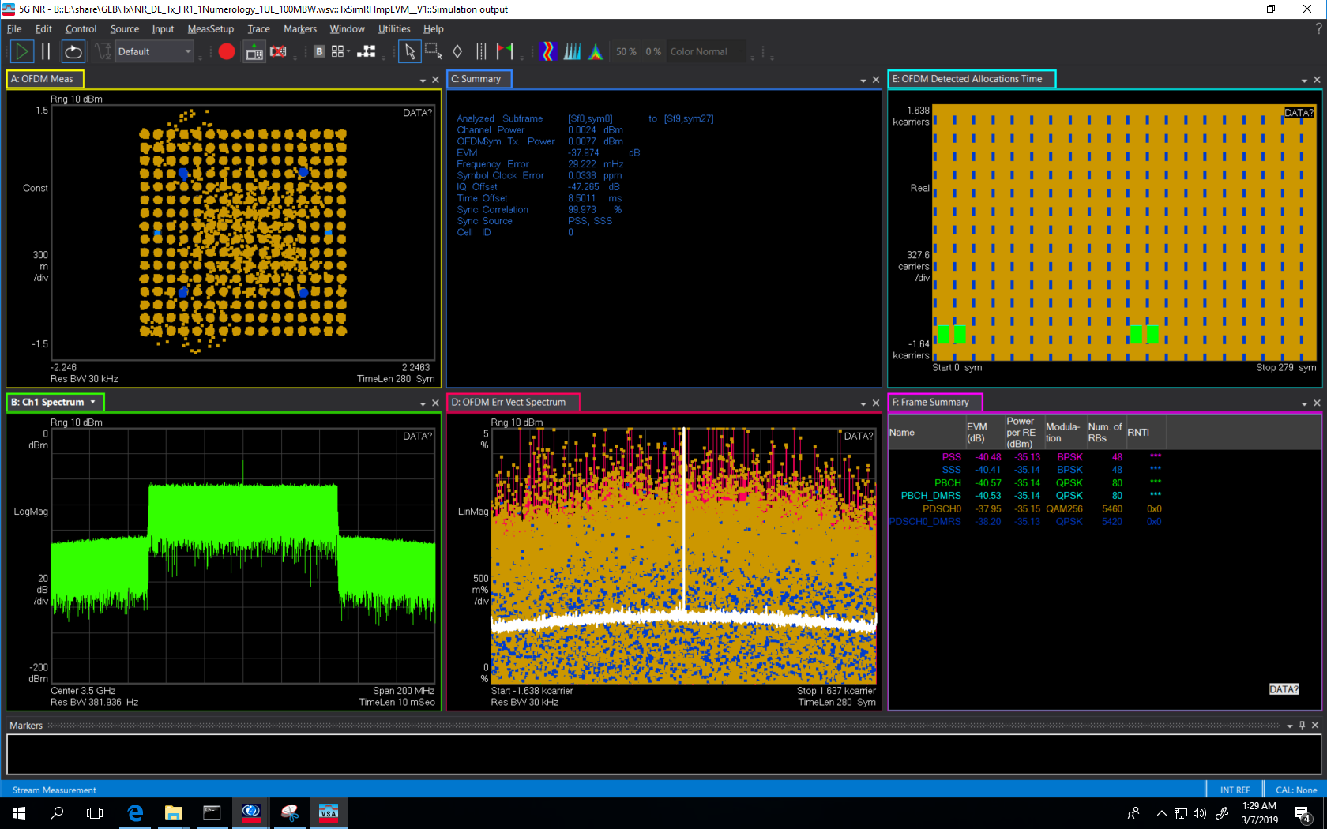
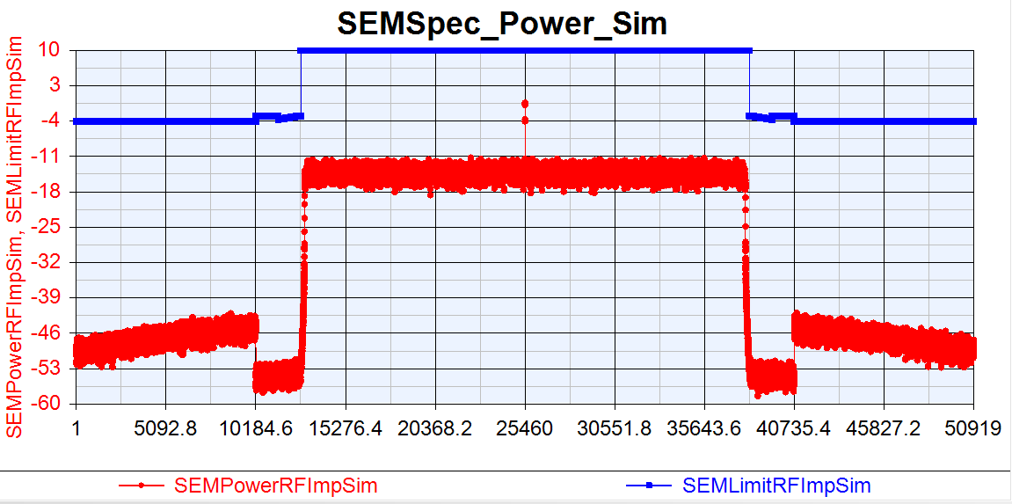
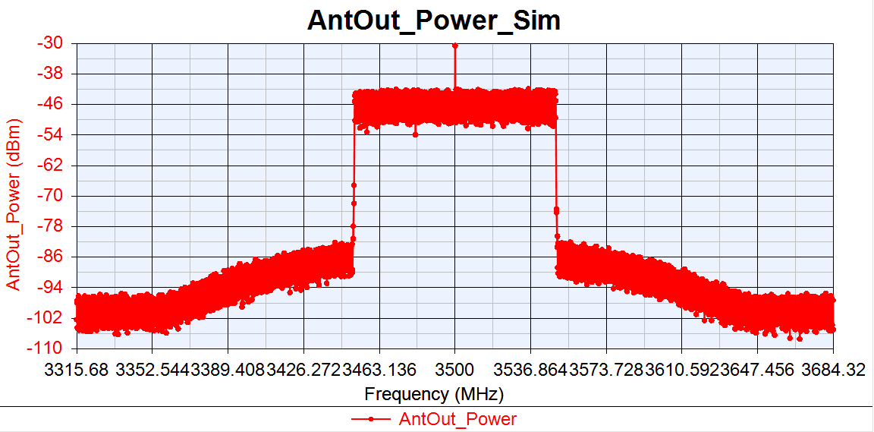
VXT-II vs SV Sim: PA_TOI=20dBm
NR DL 100MBW Tx Cable
VXT-II
EVM:-37.54dB
IQoffset:-47.549dB
EVM:-37.974dB
IQoffset:-47.265dB
Sim

Slide 11
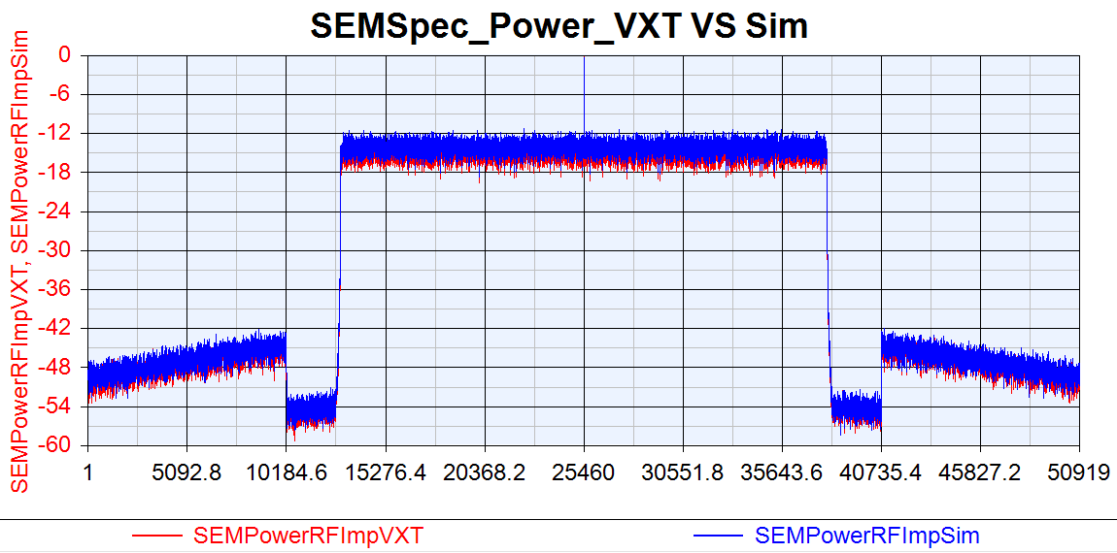
VXT SEM VS Sim SEM: PA_TOI=20dBm

Slide 12
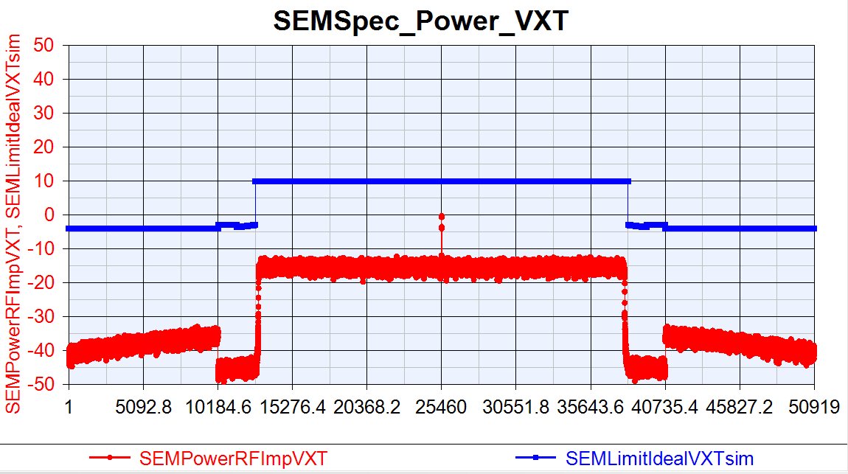
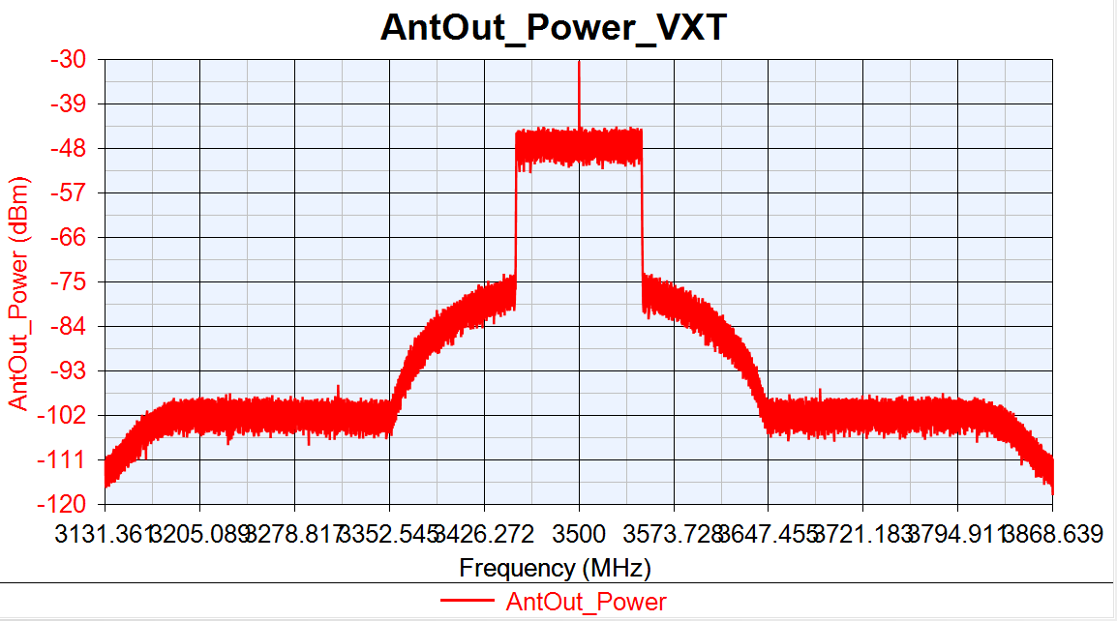
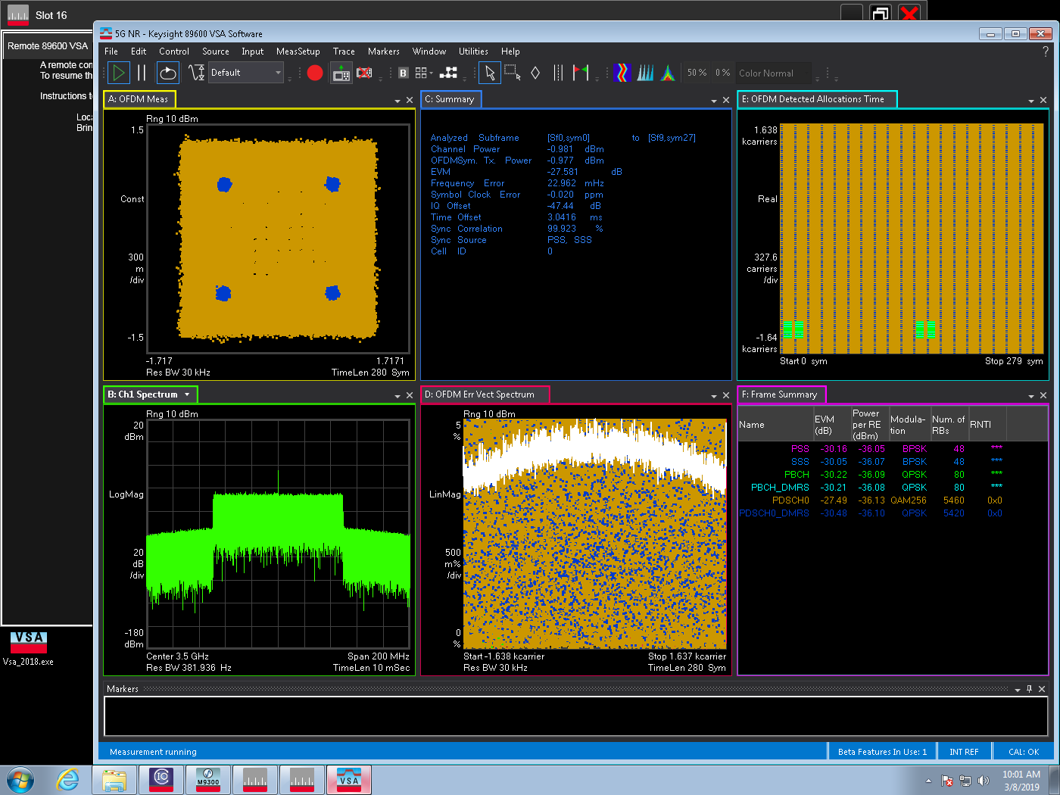
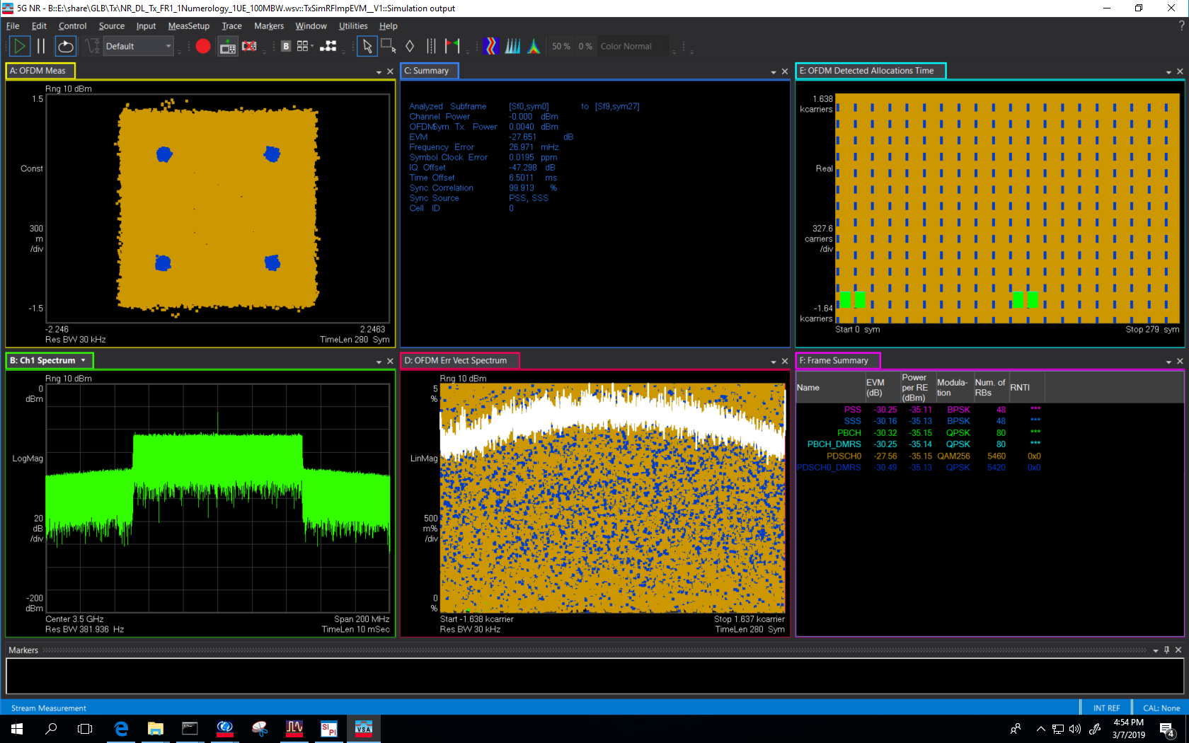
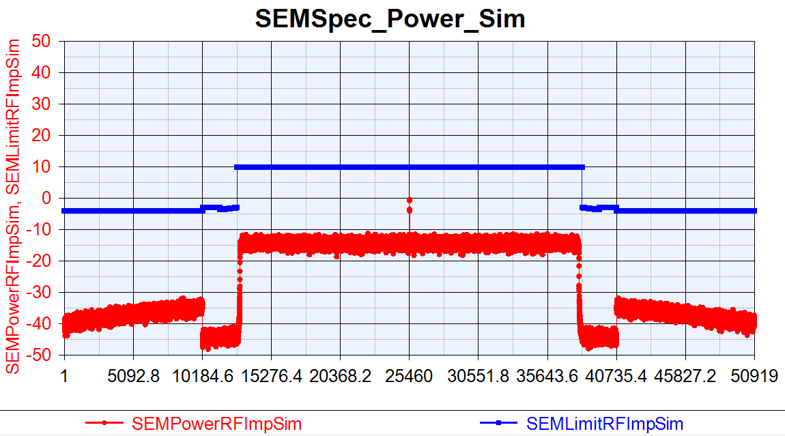
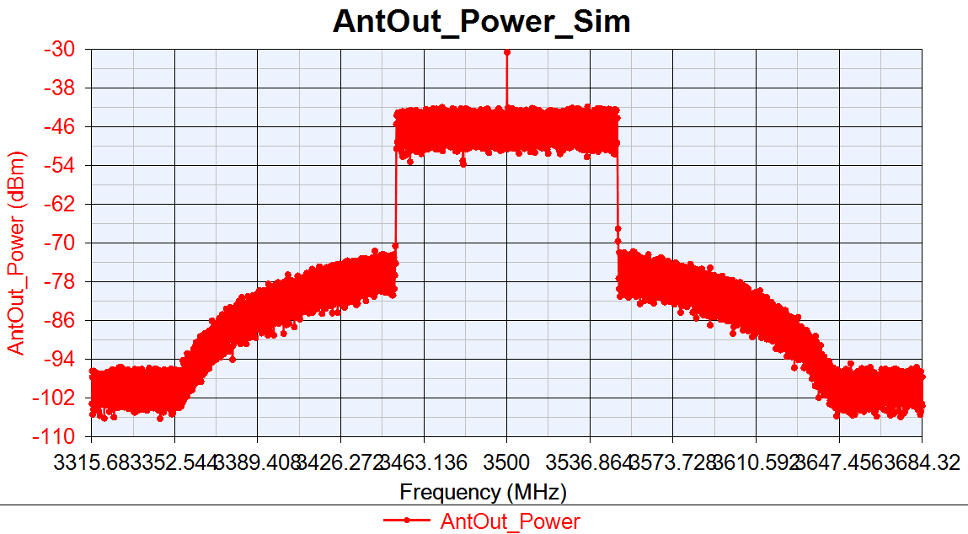
VXT-II vs SV Sim: PA_TOI=15dBm
NR DL 100MBW Tx Cable
VXT-II
EVM:-27.581dB
IQoffset:-47.44dB
EVM:-27.651dB
IQoffset:-47.298dB
Sim

Slide 13
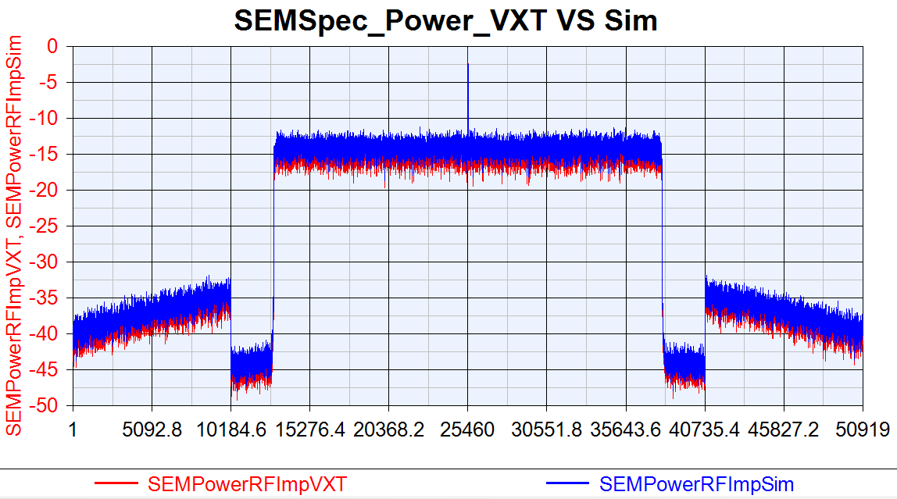
VXT SEM VS Sim SEM: PA_TOI=15dBm

Slide 14
NR DL SISO Tx EVM/ACLR vs Phase Noise
RF Imp | EVM(dB) |  |  | 1BW_Upper_ACLR |  |  | 1BW_Lower_ACLR
Phase Noise | VXT | Sim | Delta | VXT | Sim | Delta | VXT | Sim | Delta
-10dB | -48.27 | -49.823 | 1.553 | 53.883 | 53.565 | 0.318 | 54.132 | 53.559 | 0.573
-15dB | -48.256 | -48.869 | 0.613 | 53.869 | 53.551 | 0.318 | 54.118 | 53.568 | 0.55
-35dB | -44.057 | -44.852 | 0.795 | 54.041 | 53.543 | 0.502 | 54.316 | 53.567 | 0.749
-40dB | -32.341 | -32.389 | 0.047 | 54.069 | 53.529 | 0.48 | 54.367 | 53.581 | 0.786
VXT-II NR Tx Cable Test Parameters
Power(dBm) | Ndensity(dBm/Hz) | DAC_Nbits(Bits) | Gain Imbalance(dB) | IQ Offset (dB) | PA_TOI(dBm)
0 | -133.9 | 14 | 0.002 | 0.0044 | 30

Slide 15
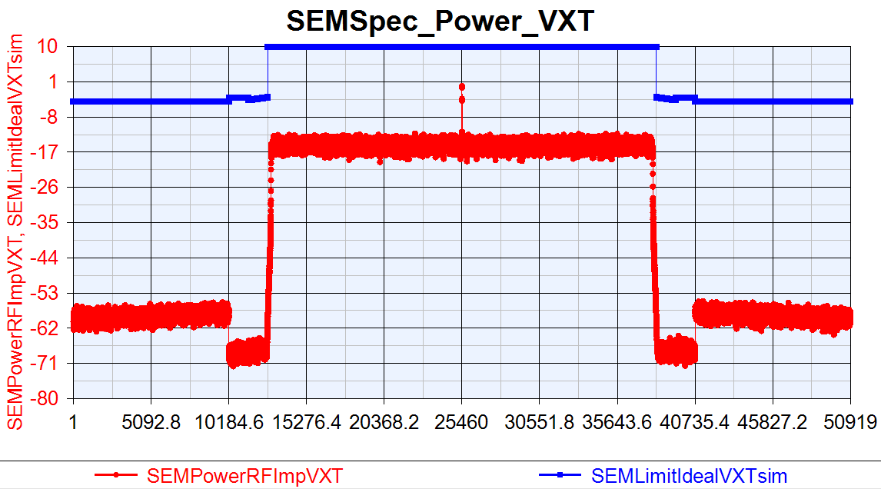
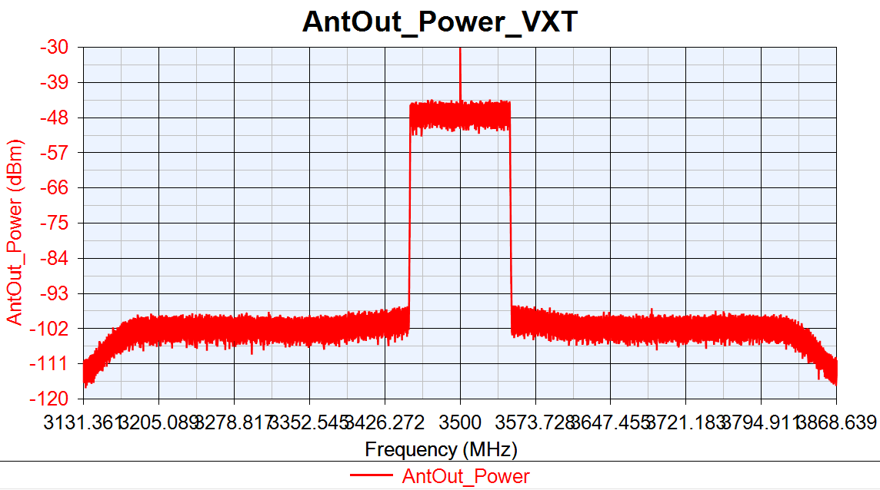
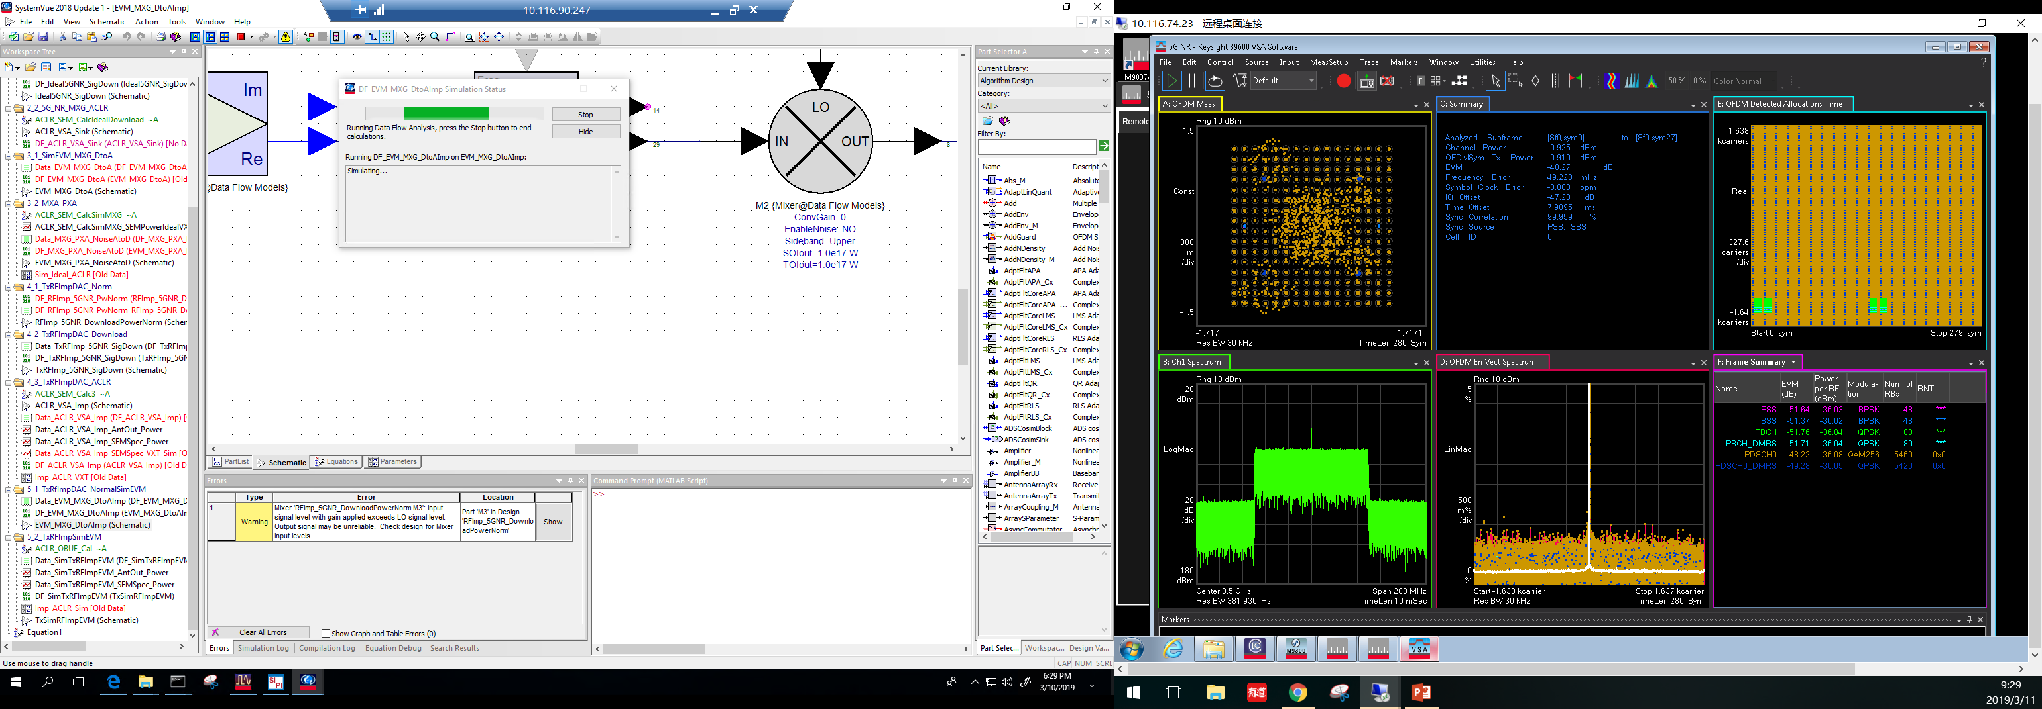
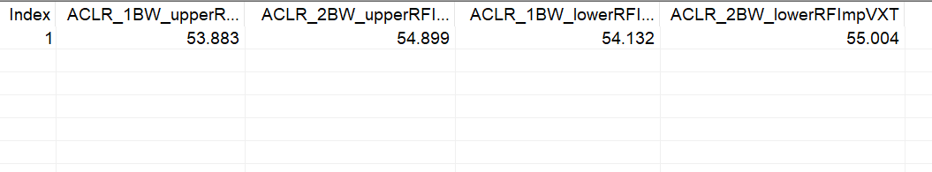
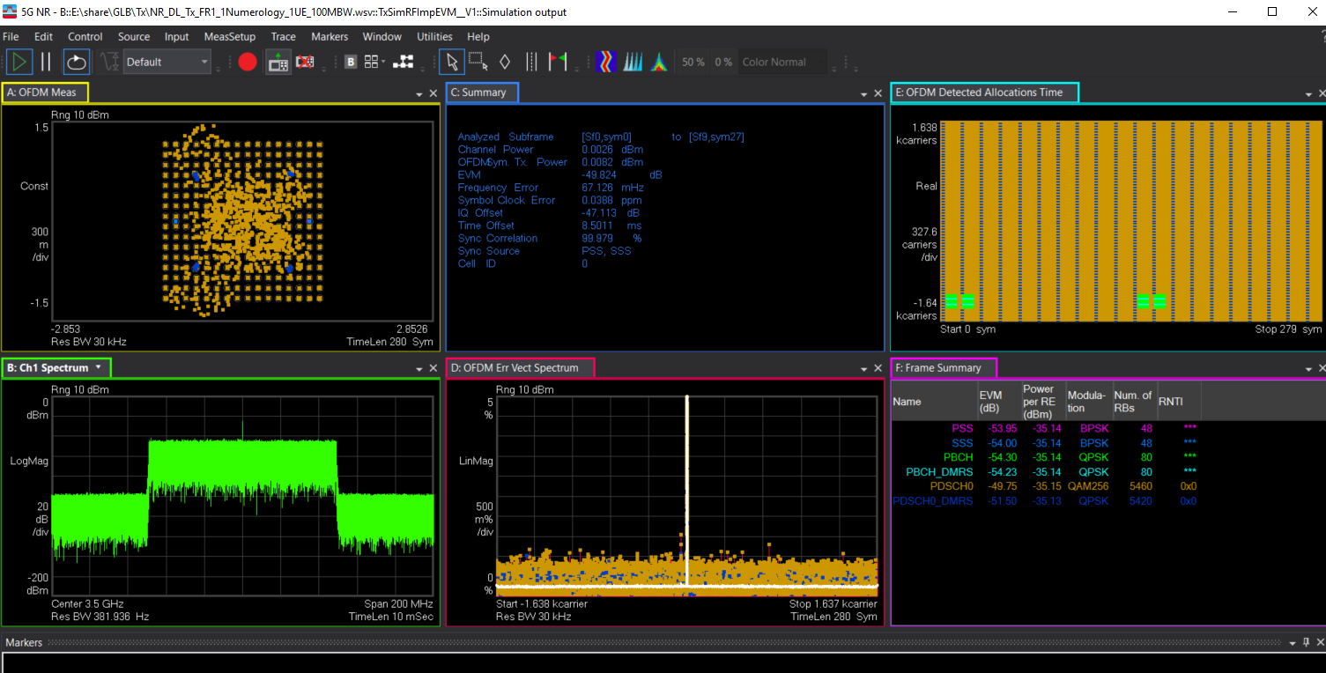

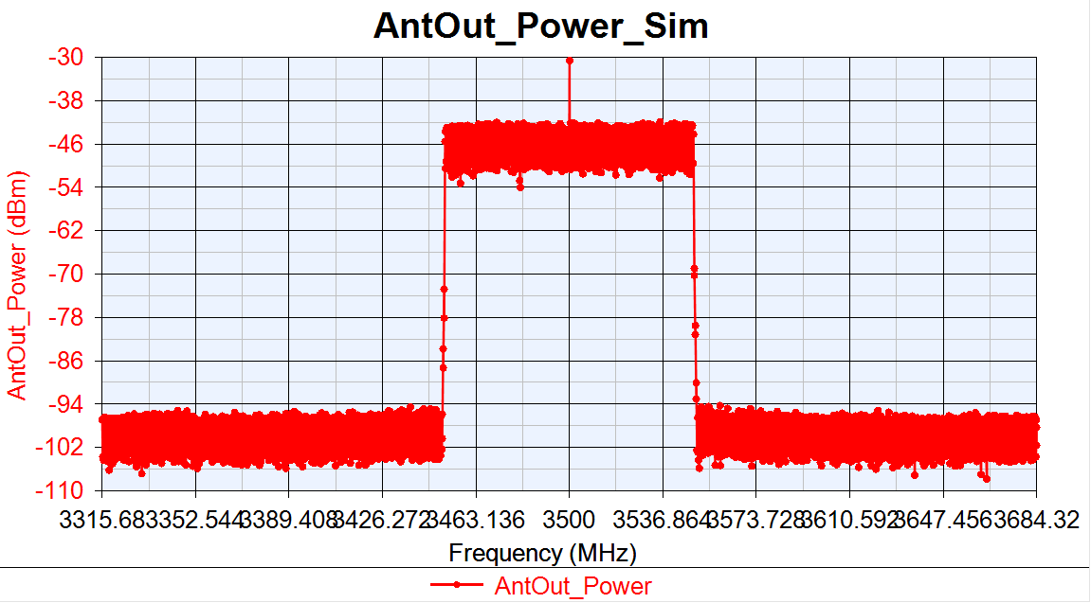
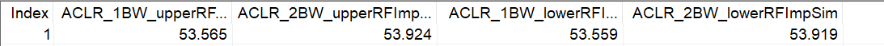
VXT-II vs SV Sim: PhaseNoise =[100, -87.133, 1000, -96.072, 1e5, -108.607]
NR DL 100MBW Tx Cable
VXT-II
Sim

Slide 16
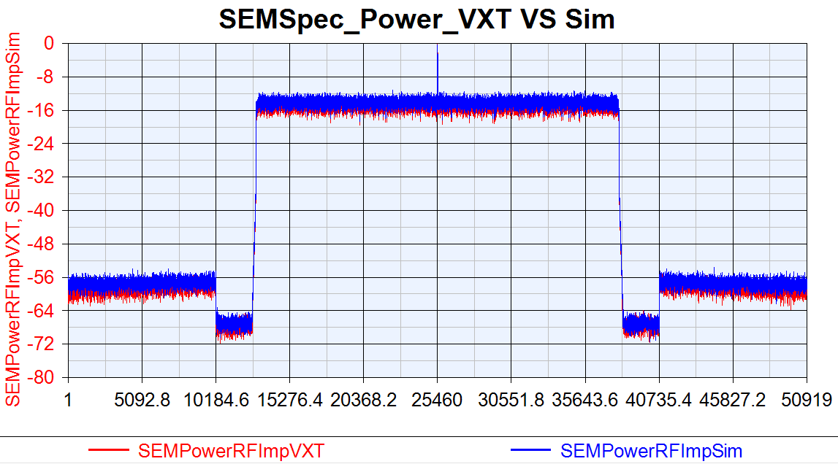
VXT SEM vs SV SEM: PhaseNoise =[100, -87.133, 1000, -96.072, 1e5, -108.607]

Slide 17
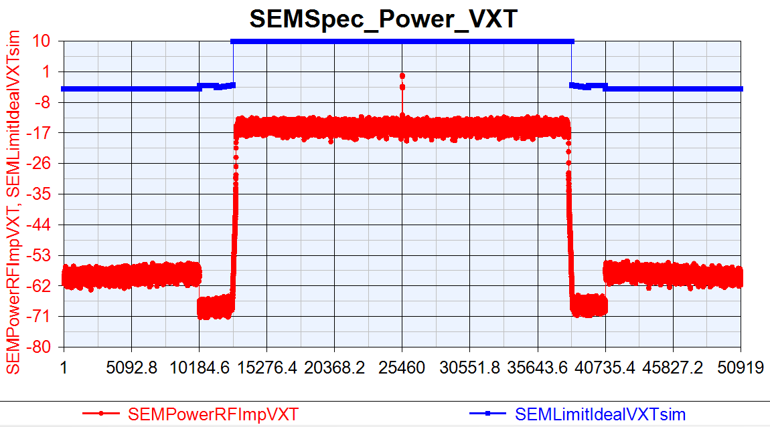
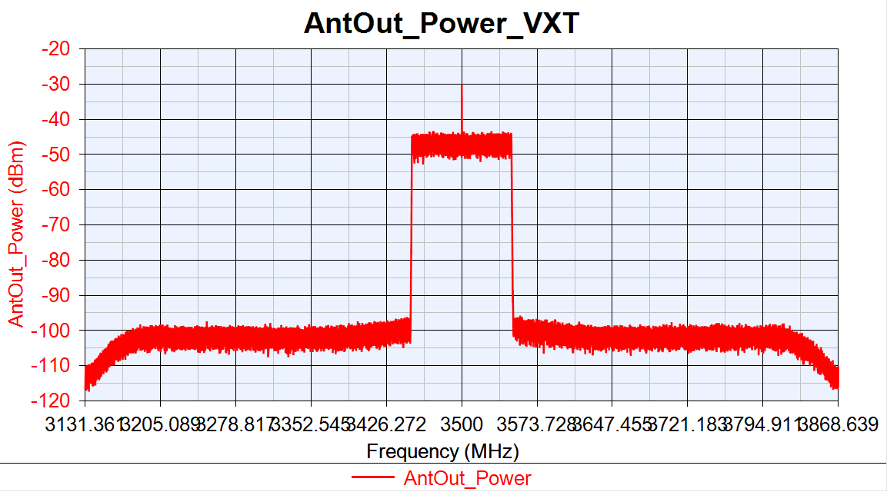
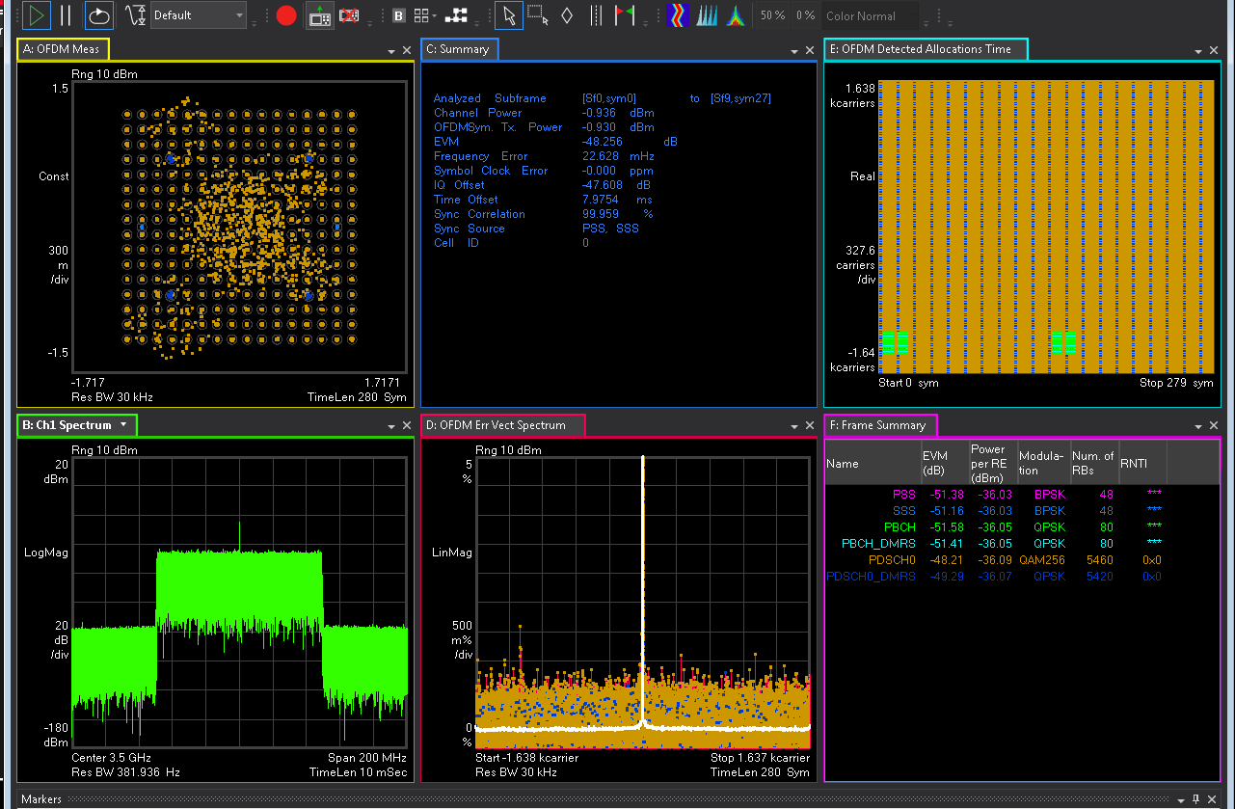
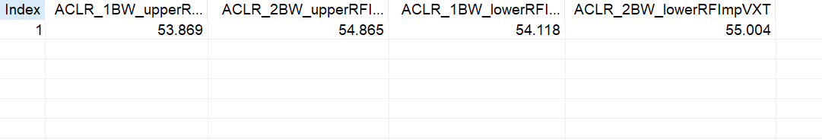

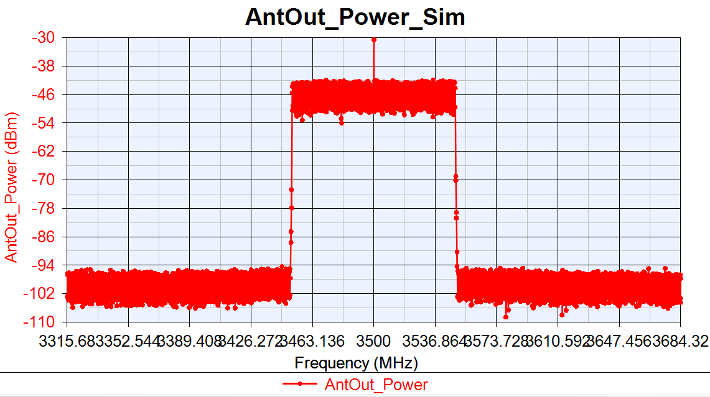
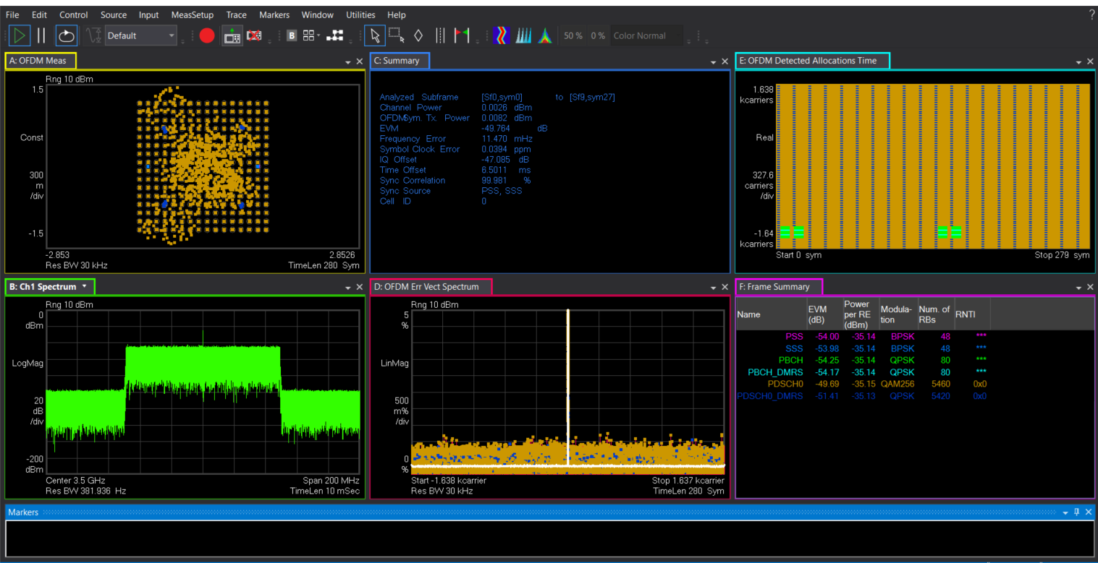
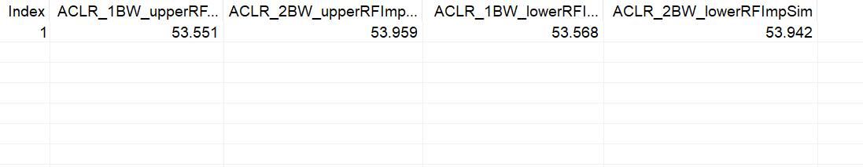
VXT-II vs SV Sim: PhaseNoise =[100, -82.133, 1000, -91.072, 1e5, -103.607]
NR DL 100MBW Tx Cable
VXT-II
EVM:-48.256dB
IQoffset:-47.608dB
EVM:-48.764dB
IQoffset:-47.085dB
Sim

Slide 18
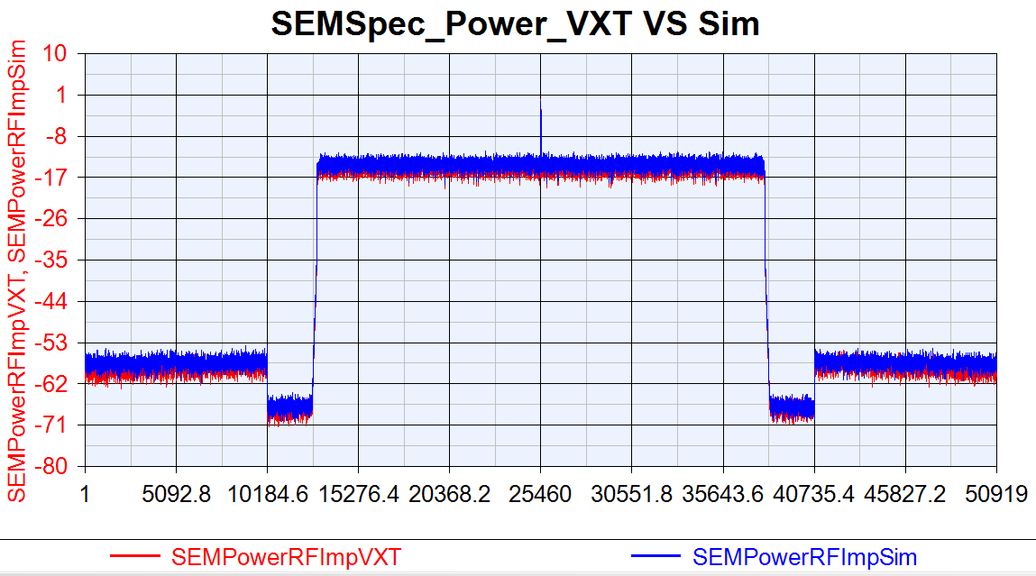
VXT SEM vs SV SEM: PhaseNoise =[100, -82.133, 1000, -91.072, 1e5, -103.607]

Slide 19
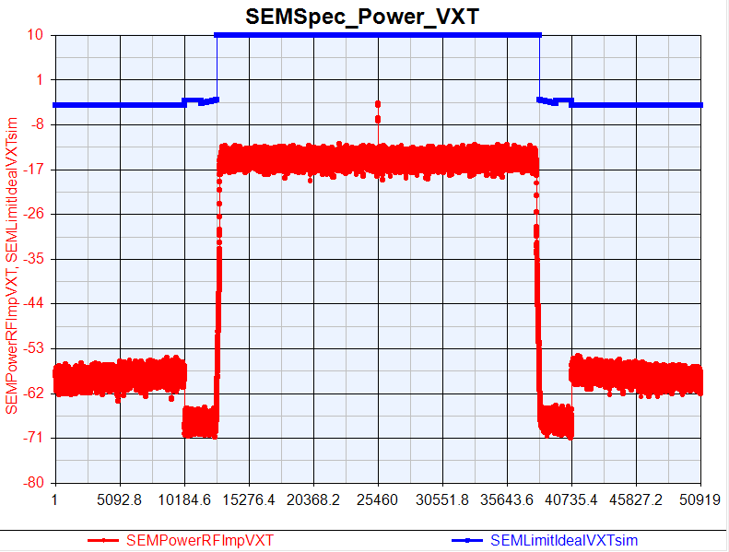
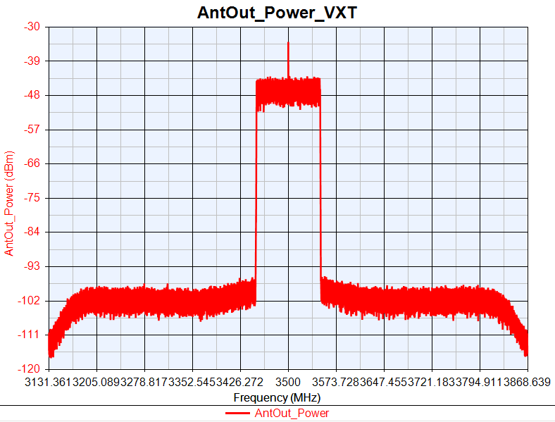
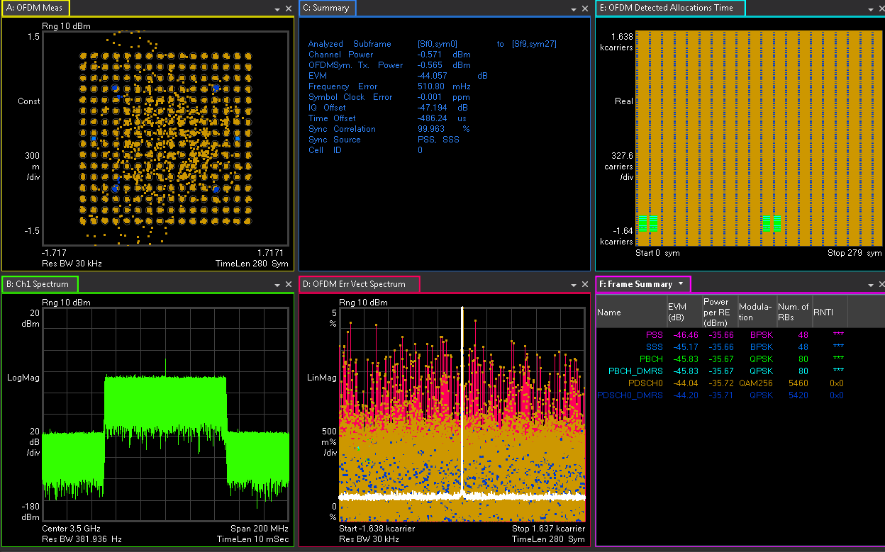
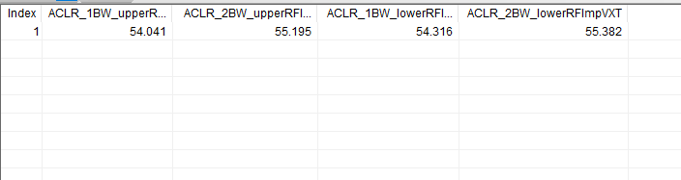
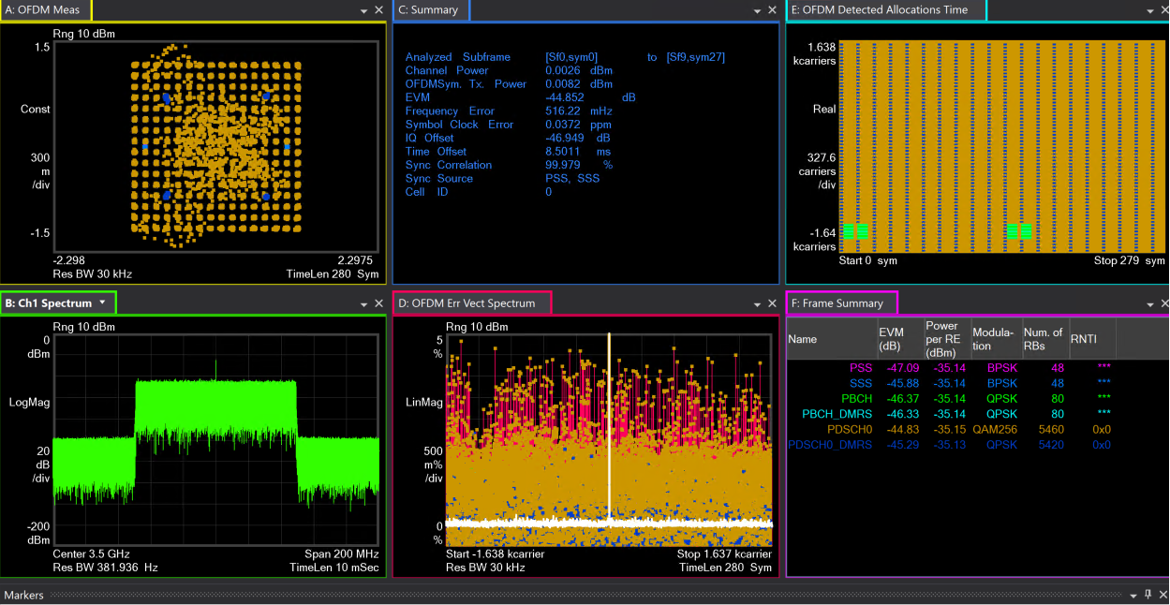
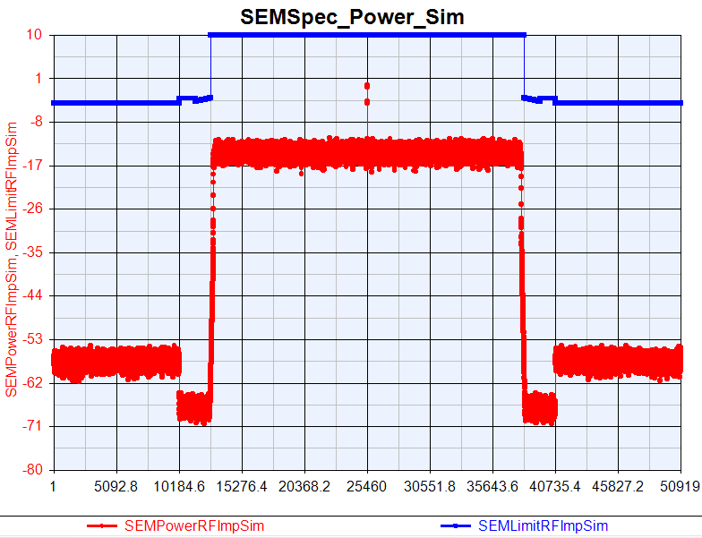
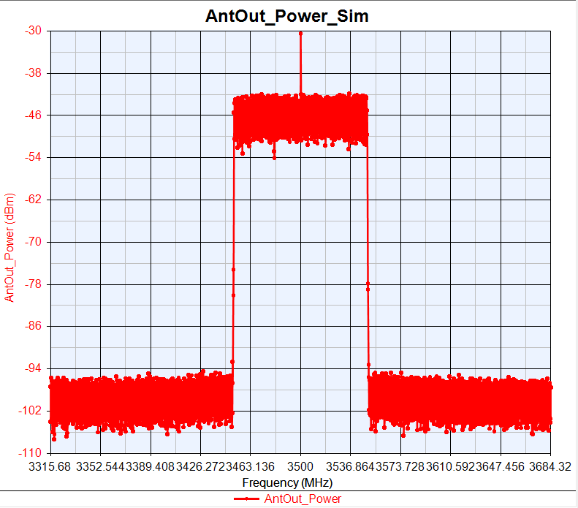
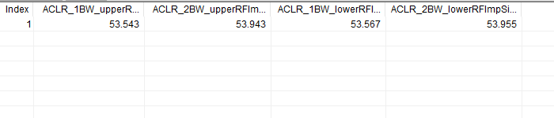
VXT-II vs SV Sim: PhaseNoise =[100, -62.133, 1000, -71.072, 1e4, -83.607]
NR DL 100MBW Tx Cable
VXT-II
EVM:-44.057dB
IQoffset:-47.194dB
EVM:-44.852dB
IQoffset:-46.949dB
Sim

Slide 20
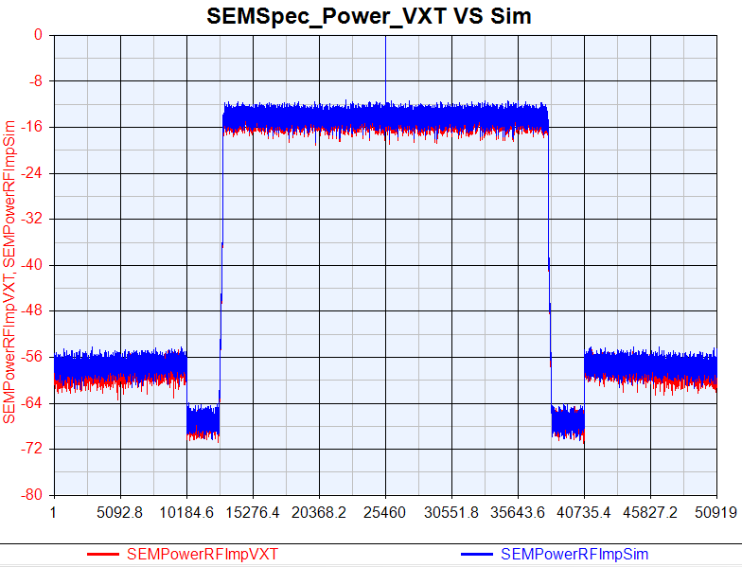
VXT SEM vs SV SEM: PhaseNoise =[100, -62.133, 1000, -71.072, 1e4, -83.607]

Slide 21
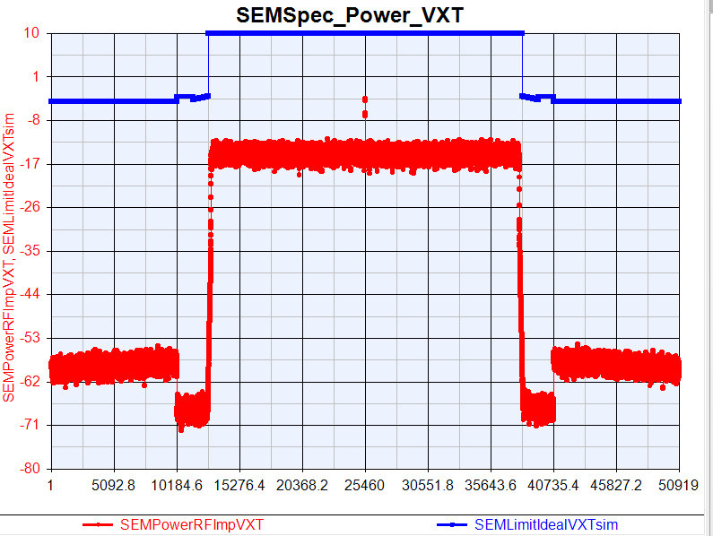
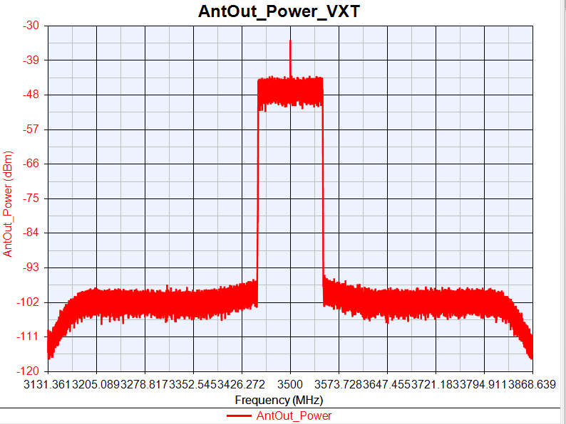
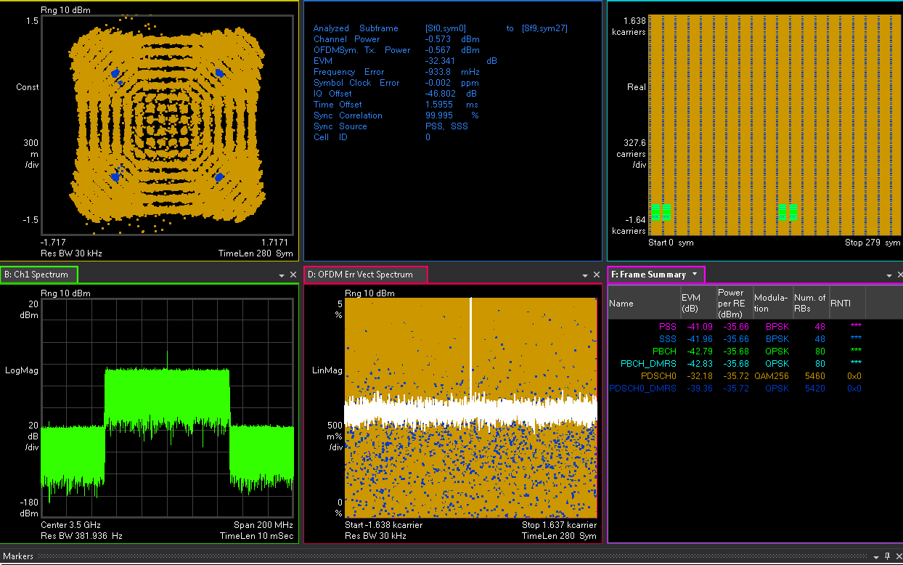
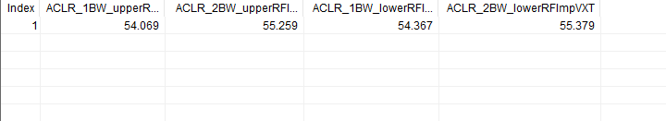
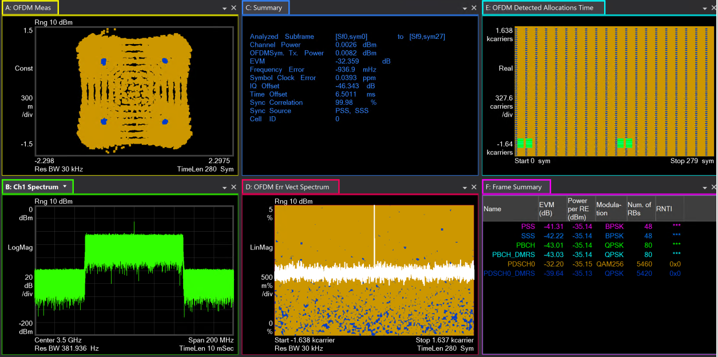



VXT-II vs SV Sim: PhaseNoise = [100, -57.133, 1000, -66.072, 1e4, -78.607]
NR DL 100MBW Tx Cable
VXT-II
EVM:-32.341dB
IQoffset:46.802dB
EVM:-32.359dB
IQoffset:-46.343dB
Sim

Slide 22

VXT SEM vs SV SEM: PhaseNoise = [100, -57.133, 1000, -66.072, 1e4, -78.607]

Slide 23
NR DL SISO Tx EVM/ACLR vs DAC_Nbits
RF Imp | EVM(dB) |  |  | 1BW_Upper_ACLR |  |  | 1BW_Lower_ACLR
DAC Nbits | VXT | Sim | Delta | VXT | Sim | Delta | VXT | Sim | Delta
14 | -48.458 | -49.843 | 1.385 | 53.743 | 53.563 | 0.18 | 53.926 | 53.579 | 0.347
12 | -48.434 | -48.813 | 0.379 | 53.773 | 53.507 | 0.224 | 54.005 | 53.502 | 0.503
10 | -48.299 | -49.204 | 0.905 | 52.503 | 52.285 | 0.218 | 52.685 | 52.281 | 0.404
VXT-II NR Tx Cable Test Parameters
Power(dBm) | Ndensity(dBm/Hz) | PA_TOI(dBm) | Gain Imbalance(dB) | IQ Offset (dB) | Phase Noise(dBc/Hz)
0 | -133.9 | 30 | 0.002 | 0.0044 | [100, -97.133, 1000, -106.072, 1e4, -118.607]

Slide 24


VXT-II vs SV Sim: DAC_Nbits=14
NR DL 100MBW Tx Cable
VXT-II
EVM:-48.458dB
IQoffset:-47.301dB
EVM:-49.843dB
IQoffset:-47.106dB
Sim

Slide 25
VXT SEM vs SV SEM: DAC_Nbits=14

Slide 26








VXT-II vs SV Sim: DAC_Nbits=12
NR DL 100MBW Tx Cable
VXT-II
EVM:-48.434dB
IQoffset:-47.231dB
EVM:-48.813dB
IQoffset:-47.094dB
Sim

Slide 27

VXT SEM vs SV SEM: DAC_Nbits=12

Slide 28








VXT-II vs SV Sim: DAC_Nbits=10
NR DL 100MBW Tx Cable
VXT-II
EVM:-48.299dB
IQoffset:-47.494dB
EVM:-49.204dB
IQoffset:-47.121dB
Sim

Slide 29

VXT SEM vs SV SEM: DAC_Nbits=10

Slide 30
NR DL SISO Tx EVM/ACLR vs Gain Imbalance
RF Imp | EVM(dB) |  |  | 1BW_Upper_ACLR |  |  | 1BW_Lower_ACLR
Gain Imbalance | VXT | Sim | Delta | VXT | Sim | Delta | VXT | Sim | Delta
0.02 | -48.323 | -49.2 | 0.877 | 53.876 | 53.584 | 0.292 | 54.134 | 53.575 | 0.559
0.03 | -47.5 | -48.261 | 0.761 | 53.898 | 53.561 | 0.337 | 54.106 | 53.593 | 0.513
0.1 | -42.374 | -43.165 | 0.791 | 54.046 | 53.591 | 0.455 | 54.305 | 53.588 | 0.717
0.3 | -34.544 | -34.746 | 0.202 | 54.071 | 53.569 | 0.502 | 54.308 | 53.59 | 0.718
VXT-II NR Tx Cable Test Parameters
Power(dBm) | Ndensity(dBm/Hz) | PA_TOI(dBm) | DAC_Nbits | IQ Offset (dB) | Phase Noise(dBc/Hz)
0 | -133.9 | 30 | 14 | 0.0044 | [100, -97.133, 1000, -106.072, 1e4, -118.607]

Slide 31








VXT-II vs SV Sim: Gain Imbalance=0.02
NR DL 100MBW Tx Cable
VXT-II
EVM:-48.323dB
IQoffset:-47.442dB
EVM:-49.2dB
IQoffset:-47.144dB
Sim

Slide 32

VXT SEM vs SV SEM: Gain Imbalance=0.02

Slide 33








VXT-II vs SV Sim: Gain Imbalance=0.02
NR DL 100MBW Tx Cable
VXT-II
EVM:-47.5dB
IQoffset:-47.344dB
EVM:-48.261dB
IQoffset:-47.139dB
Sim

Slide 34

VXT SEM VS Sim SEM: Gain Imbalance=0.02

Slide 35








VXT-II vs SV Sim: Gain Imbalance=0.1
NR DL 100MBW Tx Cable
VXT-II
EVM:-42.374dB
IQoffset:-47.161dB
EVM:-43.165dB
IQoffset:-47.16dB
Sim

Slide 36

VXT SEM VS Sim SEM : Gain Imbalance=0.1

Slide 37








VXT-II vs SV Sim: Gain Imbalance=0.3
NR DL 100MBW Tx Cable
VXT-II
EVM:-34.544dB
IQoffset:-47.223dB
EVM:-34.746dB
IQoffset:-47.117dB
Sim

Slide 38

VXT SEM VS Sim SEM : Gain Imbalance=0.3

Slide 39
NR DL SISO Tx EVM/ACLR vs IQ offset
RF Imp | EVM(dB) |  |  | 1BW_Upper_ACLR |  |  | 1BW_Lower_ACLR
IQ offset | VXT | Sim | Delta | VXT | Sim | Delta | VXT | Sim | Delta
0.014 | -48.308 | -49.806 | 1.498 | 53.839 | 53.603 | 0.236 | 54.134 | 53.586 | 0.548
0.025 | -48.302 | -49.553 | 1.251 | 53.852 | 53.602 | 0.25 | 54.143 | 53.607 | 0.536
0.2 | -41.065 | -42.133 | 1.068 | 54.045 | 53.421 | 0.624 | 54.269 | 53.449 | 0.82
0.4 | -32.981 | -33.456 | 0.475 | 54.07 | 53.377 | 0.693 | 54.284 | 53.388 | 0.896
VXT-II NR Tx Cable Test Parameters
Power(dBm) | Ndensity(dBm/Hz) | PA_TOI(dBm) | DAC_Nbits | Gain Imbalance (dB) | Phase Noise(dBc/Hz)
0 | -133.9 | 30 | 14 | 0.002 | [100, -97.133, 1000, -106.072, 1e4, -118.607]

Slide 40








VXT-II vs SV Sim: IQ offset=0.014
NR DL 100MBW Tx Cable
VXT-II
EVM:-48.308dB
IQoffset:-40.798dB
EVM:-49.806dB
IQoffset:-41.287dB
Sim

Slide 41

VXT SEM VS Sim SEM : IQ offset=0.014

Slide 42








VXT-II vs SV Sim: IQ offset=0.025
NR DL 100MBW Tx Cable
VXT-II
EVM:-48.302dB
IQoffset:-36.779dB
EVM:-49.553dB
IQoffset:-36.658dB
Sim

Slide 43

VXT SEM VS Sim SEM : IQ offset=0.025

Slide 44








VXT-II vs SV Sim: IQ offset=0.2
NR DL 100MBW Tx Cable
VXT-II
EVM:-41.056dB
IQoffset:-40.803dB
EVM:-42.133dB
IQoffset:-40.764dB
Sim

Slide 45

VXT SEM VS Sim SEM : IQ offset=0.2

Slide 46








VXT-II vs SV Sim: IQ offset=0.4
NR DL 100MBW Tx Cable
VXT-II
EVM:-32.981dB
IQoffset:-42.814dB
EVM:-33.456dB
IQoffset:-42.827dB
Sim

Slide 47

VXT SEM VS Sim SEM : IQ offset=0.4

Slide 48
NR DL SISO Tx EVM/ACLR vs Combine RFImp
RF Imp | EVM(dB) |  |  | 1BW_Upper_ACLR |  |  | 1BW_Lower_ACLR
Combine Test | VXT | Sim | Delta | VXT | Sim | Delta | VXT | Sim | Delta
Origin Para | -48.256 | -49.847 | 1.591 | 53.746 | 53.591 | 0.155 | 53.966 | 53.578 | 0.388
Change 5dB | -45.294 | -46.33 | 1.036 | 50.969 | 51.347 | 0.378 | 51.21 | 51.369 | 0.159
Change 10dB | -37.388 | -37.69 | 0.302 | 43.794 | 44.096 | 0.312 | 43.969 | 44.182 | 0.213
VXT-II NR Tx Cable Test Parameters
RF Imp | PA_TOI(dBm) | Power (dBm) | Ndensity (dBm/Hz) | IQ offset(dB) | DAC_Nbits | Gain Imbalance (dB) | Phase Noise(dBc/Hz)
Origin Para | 30 | 0 | -133.9 | 30 | 14 | 0.002 | [100, -97.133, 1000, -106.072, 1e4, -118.607]
Change 5dB | 25 | 0 | -133.9 | 0.0079 | 12 | 0.01 | 100, -92.133, 1000, -101.072, 1e4, -113.607]
Change 10dB | 20 | 0 | -133.9 | 0.014 | 10 | 0.02 | 100, -87.133, 1000, -96.072, 1e4, -108.607]

Slide 49








VXT-II vs SV Sim: Origin Para
NR DL 100MBW Tx Cable
VXT-II
EVM:-48.256dB
IQoffset:-47.392dB
EVM:-49.847dB
IQoffset:-47.147dB
Sim

Slide 50

VXT SEM VS Sim SEM : Origin Para

Slide 51








VXT-II vs SV Sim: Change 5dB
NR DL 100MBW Tx Cable
VXT-II
EVM:-45.294dB
IQoffset:-44.951dB
EVM:-46.33dB
IQoffset:-45.377dB
Sim

Slide 52

VXT SEM VS Sim SEM : Change 5dB

Slide 53








VXT-II vs SV Sim: Change 10dB
NR DL 100MBW Tx Cable
VXT-II
EVM:-37.388dB
IQoffset:-40.8dB
EVM:-37.69dB
IQoffset:-41.316dB
Sim

Slide 54

VXT SEM VS Sim SEM : Change 10dB

Slide 55
NR DL SISO Tx EVM/ACLR OTA Test
 | EVM(dB) |  |  | 1BW_Upper_ACLR |  |  | 1BW_Lower_ACLR
OTA Test | VXT | Sim | Delta | VXT | Sim | Delta | VXT | Sim | Delta
Ideal Signal | -42.26 | -42.29 | 0.03 | 44.46 | 43.096 | 1.364 | 44.84 | 43.104 | 1.736
RFImp Signal | -34.409 | -34.924 | 0.515 | 41.013 | 40.712 | 0.301 | 40.823 | 40.744 | 0.079
VXT-II NR Tx OTA Test Parameters(Length=2.5m,Pathloss=-54.7dBm)
RF Imp | PA_TOI(dBm) | Power (dBm) | Ndensity (dBm/Hz) | IQ offset(dB) | DAC_Nbits | Gain Imbalance (dB) | Phase Noise(dBc/Hz)
Ideal RFImp (仪表参数) |  | 10 | -158.7 | 0.0045 | 14 | 0.002 | [100 -98.57 1e3 -107.56 1e4 -121.67]
Test RFImp | 20 | 10 | -158.7 | 0.045 | 12 | 0.02 | [100 -88.57 1e3 -97.56 1e4 -111.67]

Slide 56








VXT-II vs SV Sim: Ideal signal
NR DL 100MBW Tx Cable
VXT-II
EVM=-42.26
IQ offset=-46.947
EVM=-42. 29
IQ offset=-47.115
Sim

Slide 57

VXT SEM VS Sim SEM : Ideal signal

Slide 58








VXT-II vs SV Sim: RFImp signal
NR DL 100MBW Tx Cable
VXT-II
EVM=-34.409
IQ offset=-35.376
EVM=-34.924
IQ offset=-35.443
Sim

Slide 59

VXT SEM VS Sim SEM : RFImp signal

Slide 60
NR DL SISO Sensitivity EVM/Throughput vs Noise Figure
Noise Figure | VXT_EVM (%) | Sim_EVM (%) | Delta (%) | VXT_SNR (dB) | Sim_SNR (dB) | Delta (dB) | VXT_ Throughput (%) | Sim_ Throughput (%)
0 | 75.797 | 77.288 | 1.491 | 2.407 | 2.238 | 0.169 | 100 | 100
5 | 123.972 | 125.789 | 1.817 | -1.866 | -1.993 | 0.127 | 100 | 100
7 | 185.612 | 167.28 | 18.332 | -5.372 | -4.469 | 0.903 | 68 | 90
10 | 323.36 | 333.448 | 10.088 | -10.194 | -10.461 | 0.267 | 0 | 0
VXT-II NR Sensitivity Cable Test Parameters
Power(dBm) | Ndensity(dBm/Hz) | Gain Imbalance(dB) | ADC_Nbits | IQ offset (dB) | Phase Noise(dBc/Hz)
0 | -133.9 | 0.002 | 14 | 0.0044 | [100, -97.133, 1000, -106.072, 1e4, -118.607]

Slide 61










VXT-II vs SV Sim: Noise Figure=0
NR DL 100MBW Tx Cable
VXT-II
Sim

Slide 62










VXT-II vs SV Sim: Noise Figure=5
NR DL 100MBW Tx Cable
VXT-II
Sim

Slide 63










VXT-II vs SV Sim: Noise Figure=7
NR DL 100MBW Tx Cable
VXT-II
Sim

Slide 64










VXT-II vs SV Sim: Noise Figure=5
NR DL 100MBW Tx Cable
VXT-II
Sim

Slide 65
NR DL SISO Sensitivity EVM/Throughput vs Phase Noise
Phase Noise | VXT_EVM (%) | Sim_EVM (%) | Delta (%) | VXT_SNR (dB) | Sim_SNR (dB) | Delta (dB) | VXT_ Throughput (%) | Sim_ Throughput (%)
Change 10dB | 76.216 | 78.395 | 2.179 | 2.359 | 2.114 | 0.245 | 100 | 100
Change 15dB | 78.29 | 78.628 | 0.338 | 2.126 | 2.088 | 0.038 | 100 | 100
Change 65dB | 150.145 | 139.692 | 10.453 | -3.53 | -2.903 | 0.627 | 64 | 60
VXT-II NR Sensitivity Cable Test Parameters
Power(dBm) | Ndensity(dBm/Hz) | Gain Imbalance(dB) | ADC_Nbits | IQ offset (dB) | Noise Figure
0 | -133.9 | 0.002 | 14 | 0.0044 | 0

Slide 66










VXT-II vs SV Sim: Phase Noise= [100, -87.133, 1000, -96.072, 1e4, -108.607]
NR DL 100MBW Tx Cable
VXT-II
Sim

Slide 67










VXT-II vs SV Sim: Phase Noise= [100, -82.133, 1000, -91.072, 1e4, -103.607]
NR DL 100MBW Tx Cable
VXT-II
Sim

Slide 68
VXT-II vs SV Sim: Noise Figure=5
NR DL 100MBW Tx Cable
VXT-II
Sim

Slide 69





VXT PhaseNoise=[100, -32.133, 1000, -41.072, 1e4, -53.607]

Slide 70





Sim PhaseNoise=[100, -32.133, 1000, -41.072, 1e4, -53.607]

Slide 71
Sensitivity Single RFImp Gain Imbalance Test
LNA_NoiseFigure = 0;
RxGainImbalance = 0.02;
RxI_OrgOffset = 0.0044;
RxPhaseNoise = [100, -97.133, 1000, -106.072, 1e4, -118.607];
ADC_NBits = 14;
SV_Power=-94.6dBm
Powerout=0dBm
NoiseDensity=-133.9
LNA_NoiseFigure = 0;
RxGainImbalance = 0.03;
RxI_OrgOffset = 0.0044;
RxPhaseNoise = [100, -97.133, 1000, -106.072, 1e4, -118.607];
ADC_NBits = 14;
SV_Power=-94.6dBm
Powerout=0dBm
NoiseDensity=-133.9
LNA_NoiseFigure = 0;
RxGainImbalance = 20;
RxI_OrgOffset = 0.0044;
RxPhaseNoise = [100, -97.133, 1000, -106.072, 1e4, -118.607];
ADC_NBits = 14;
SV_Power=-94.6dBm
Powerout=0dBm
NoiseDensity=-133.9

Slide 72
Sensitivity Single RFImp Gain Imbalance Test
Gain Imbalance | VXT_EVM (%) | Sim_EVM (%) | Delta (%) | VXT_SNR (dB) | Sim_SNR (dB) | Delta (dB) | VXT_ Throughput (%) | Sim_ Throughput (%)
0.02 | 77.61 | 79.184 | 1.574 | 2.202 | 2.027 | 0.175 | 100 | 100
0.03 | 80.095 | 82.13 | 2.035 | 1.928 | 1.71 | 0.218 | 100 | 100
20 | 151.952 | 152.79 | 0.838 | -3.634 | -3.682 | 0.048 | 88 | 70

Slide 73





VXT GainImbalance=0.02

Slide 74





Sim GainImbalance=0.02

Slide 75





VXT GainImbalance=0.03

Slide 76





Sim GainImbalance=0.03

Slide 77





VXT GainImbalance=20

Slide 78





Sim GainImbalance=20

Slide 79
Sensitivity Single RFImp IQ offset Test
LNA_NoiseFigure = 0;
RxGainImbalance = 0.002;
RxI_OrgOffset = 0.014;
RxPhaseNoise = [100, -97.133, 1000, -106.072, 1e4, -118.607];
ADC_NBits = 14;
SV_Power=-94.6dBm
Powerout=0dBm
NoiseDensity=-133.9
LNA_NoiseFigure = 0;
RxGainImbalance = 0.002;
RxI_OrgOffset = 0.025;
RxPhaseNoise = [100, -97.133, 1000, -106.072, 1e4, -118.607];
ADC_NBits = 14;
SV_Power=-94.6dBm
Powerout=0dBm
NoiseDensity=-133.9
LNA_NoiseFigure = 0;
RxGainImbalance = 0.002;
RxI_OrgOffset = 1.2;
RxPhaseNoise = [100, -97.133, 1000, -106.072, 1e4, -118.607];
ADC_NBits = 14;
SV_Power=-94.6dBm
Powerout=0dBm
NoiseDensity=-133.9

Slide 80
Sensitivity Single RFImp IQ offset Test
IQ offset | VXT_EVM (%) | Sim_EVM (%) | Delta (%) | VXT_SNR (dB) | Sim_SNR (dB) | Delta (dB) | VXT_ Throughput (%) | Sim_ Throughput (%)
0.014 | 78.095 | 78.846 | 0.751 | 2.148 | 2.064 | 0.084 | 100 | 100
0.025 | 84.547 | 84.778 | 0.231 | 1.458 | 1.434 | 0.024 | 100 | 100
1.2 | 624.005 | 655.333 | 31.328 | -15.904 | -16.328 | 0.424 | 58 | 50

Slide 81





VXT IQ offset=0.014

Slide 82





Sim IQ offset=0.014

Slide 83





VXT IQ offset=0.025

Slide 84





Sim IQ offset=0.025

Slide 85





VXT IQ offset=1.2

Slide 86





Sim IQ offset=1.2

Slide 87
Sensitivity Single RFImp ADC_Nbits Test
LNA_NoiseFigure = 0;
RxGainImbalance = 0.002;
RxI_OrgOffset = 0.0044;
RxPhaseNoise = [100, -97.133, 1000, -106.072, 1e4, -118.607];
ADC_NBits = 14;
SV_Power=-94.6dBm
Powerout=0dBm
NoiseDensity=-133.9
LNA_NoiseFigure = 0;
RxGainImbalance = 0.002;
RxI_OrgOffset = 0.0044;
RxPhaseNoise = [100, -97.133, 1000, -106.072, 1e4, -118.607];
ADC_NBits = 12;
SV_Power=-94.6dBm
Powerout=0dBm
NoiseDensity=-133.9
LNA_NoiseFigure = 0;
RxGainImbalance = 0.002;
RxI_OrgOffset = 0.0044;
RxPhaseNoise = [100, -97.133, 1000, -106.072, 1e4, -118.607];
ADC_NBits = 10;
SV_Power=-94.6dBm
Powerout=0dBm
NoiseDensity=-133.9

Slide 88
Sensitivity Single RFImp ADC_Nbits Test
ADC_ Nbits | VXT_EVM (%) | Sim_EVM (%) | Delta (%) | VXT_SNR (dB) | Sim_SNR (dB) | Delta (dB) | VXT_ Throughput (%) | Sim_ Throughput (%)
14 | 75.797 | 77.288 | 1.491 | 2.407 | 2.238 | 0.169 | 100 | 100
12 | 78.357 | 80.035 | 1.678 | 2.118 | 1.934 | 0.184 | 100 | 100
10 | 79.693 | 81.703 | 2.01 | 1.972 | 1.755 | 0.217 | 100 | 100

Slide 89
VXT ADC_Nbits=14

Slide 90
VXT ADC_Nbits=14

Slide 91





VXT ADC_Nbits=12

Slide 92





Sim ADC _Nbits=12

Slide 93





VXT ADC _Nbits=10

Slide 94





Sim ADC _Nbits=10

Slide 95
Sensitivity Combine RFImp Test
Combine Test
LNA_NoiseFigure = 0;
RxGainImbalance = 0.002;
RxI_OrgOffset = 0.0044;
RxPhaseNoise = [100, -87.133, 1000, -96.072, 1e4, -108.607];
ADC_NBits = 14;
SV_Power=-94.6dBm
Powerout=0dBm
NoiseDensity=-133.9
Combine Test (Change 5dB):
LNA_NoiseFigure = 5;
RxGainImbalance = 0.01;
RxI_OrgOffset = 0.0079;
RxPhaseNoise = [100, -92.133, 1000, -101.072, 1e4, -113.607];
ADC_NBits = 12;
SV_Power=-94.6dBm
Powerout=0dBm
NoiseDensity=-133.9
Combine Test (Change 10dB):
LNA_NoiseFigure = 7;
RxGainImbalance = 0.02;
RxI_OrgOffset = 0.014;
RxPhaseNoise = [100, -87.133, 1000, -96.072, 1e4, -108.607];
ADC_NBits = 10;
SV_Power=-94.6dBm
Powerout=0dBm
NoiseDensity=-133.9

Slide 96
Sensitivity Combine RFImp Test
Combine Test | VXT_EVM (%) | Sim_EVM (%) | Delta (%) | VXT_SNR (dB) | Sim_SNR (dB) | Delta (dB) | VXT_ Throughput (%) | Sim_ Throughput (%)
Origin | 75.797 | 77.288 | 1.491 | 2.407 | 2.238 | 0.169 | 100 | 100
Change 5dB | 134.103 | 135.736 | 1.633 | -2.549 | -2.654 | 0.105 | 100 | 100
Change 10dB | 186.985 | 209.631 | 22.646 | -5.436 | -6.429 | 0.993 | 74 | 50

Slide 97
VXT Combine Test (Origin)

Slide 98
Sim Combine Test (Origin)

Slide 99





VXT Combine Test (Change 5dB)

Slide 100





Sim Combine Test (Change 5dB)

Slide 101





VXT Combine Test (Change 10dB)

Slide 102





Sim Combine Test (Change 10dB)

Slide 103
Sensitivity OTA Test Para and RFImp Para
仪表参数：
Density=-158.7
IQoffset=0.0045
Gain Imb=0.002
PhaseNoise=[100 -98.57 1e3 -107.56 1e4 -121.67]
ADC_Nbits=14
PowerOut=10dBm
RFImp 测试参数：
Density=-158.7
IQoffset=0.045
Gain Imb=0.02
PhaseNoise=[100 -88.57 1e3 -97.56 1e4 -111.67]
ADC_Nbits=12
NoiseFigure=5
SV_Power=-94.6dBm
PowerOut=10dBm
Length=2.5m;
Pathloss=-56.7dBm

Slide 104
Sensitivity OTA Test Result
OTA Test | VXT_EVM (%) | Sim_EVM (%) | Delta (%) | VXT_SNR (dB) | Sim_SNR (dB) | Delta (dB) | VXT_ Throughput (%) | Sim_ Throughput (%)
Ideal | 78.97 | 78.121 | 0.849 | 2.051 | 2.145 | 0.094 | 100 | 100
RFImp | 142.852 | 141.416 | 1.436 | -3.098 | -3.01 | 0.088 | 100 | 100

Slide 105





VXT OTA Ideal Test

Slide 106





Sim OTA Ideal Test

Slide 107





VXT OTA RFImp Test

Slide 108





Sim OTA RFImp Test

Slide 109
Narrow Blocking Single RFImp Noise Figure Test
ADC_NBits = 14;
LNA_NoiseFigure = 0;
RxPhaseNoise = [100, -97.133, 1000, -106.072, 1e4, 118.607];
RxGainImbalance = 0.002;
RxI_OrgOffset = 0.00045;
Powerout=0dBm
NoiseDensity=-133.9
ADC_NBits = 14;
LNA_NoiseFigure = 5;
RxPhaseNoise = [100, -97.133, 1000, -106.072, 1e4, 118.607];
RxGainImbalance = 0.002;
RxI_OrgOffset = 0.00045;
Powerout=0dBm
NoiseDensity=-133.9

Slide 110
Narrow Blocking Single RFImp Noise Figure Test
ADC_NBits = 14;
LNA_NoiseFigure = 10;
RxPhaseNoise = [100, -97.133, 1000, -106.072, 1e4, 118.607];
RxGainImbalance = 0.002;
RxI_OrgOffset = 0.00045;
Powerout=0dBm
NoiseDensity=-133.9
ADC_NBits = 14;
LNA_NoiseFigure = 13;
RxPhaseNoise = [100, -97.133, 1000, -106.072, 1e4, 118.607];
RxGainImbalance = 0.002;
RxI_OrgOffset = 0.00045;
Powerout=0dBm
NoiseDensity=-133.9

Slide 111
Narrow Blocking Single RFImp Noise Figure Test
Noise Figure | VXT_EVM | Sim_EVM | Delta | VXT_Throughput | Sim_Throghput
0 | -8.099 | -7.971 | 0.128 | 100 | 100
5 | -3.329 | -3.236 | 0.093 | 100 | 100
10 | 1.909 | 1.962 | 0.053 | 100 | 100
13 | 5.688 | 5.753 | 0.065 | 60 | 15

Slide 112





VXT Noise Figure=0

Slide 113





Sim Noise Figure=0

Slide 114





VXT Noise Figure=5

Slide 115





Sim Noise Figure=5

Slide 116





VXT Noise Figure=10

Slide 117





Sim Noise Figure=10

Slide 118





VXT Noise Figure=13

Slide 119





Sim Noise Figure=13

Slide 120
Narrow Blocking Single RFImp Phase Noise Test
ADC_NBits = 14;
LNA_NoiseFigure = 0;
RxPhaseNoise = [100, -87.133, 1000, -96.072, 1e4, 108.607];
RxGainImbalance = 0.002;
RxI_OrgOffset = 0.00045;
Powerout=0dBm
NoiseDensity=-133.9
ADC_NBits = 14;
LNA_NoiseFigure = 0;
RxPhaseNoise = [100, -82.133, 1000, -91.072, 1e4, 103.607];
RxGainImbalance = 0.002;
RxI_OrgOffset = 0.00045;
Powerout=0dBm
NoiseDensity=-133.9
ADC_NBits = 14;
LNA_NoiseFigure = 0;
RxPhaseNoise = [100, -27.133, 1000, -36.072, 1e4, 48.607];
RxGainImbalance = 0.002;
RxI_OrgOffset = 0.00045;
Powerout=0dBm
NoiseDensity=-133.9

Slide 121
Narrow Blocking Single RFImp Phase Noise Test
Phase Noise | VXT_EVM | Sim_EVM | Delta | VXT_Throughput | Sim_Throghput
-10dB | -7.385 | -7.449 | 0.064 | 100 | 100
-15dB | -7.191 | -7.17 | 0.021 | 100 | 100
-70dB | 3.916 | 4.182 | 0.266 | 30 | 25

Slide 122





VXT Phase Noise =[100, -87.133, 1000, -96.072, 1e4, -108.607]

Slide 123





Sim Phase Noise =[100, -87.133, 1000, -96.072, 1e4, -108.607]

Slide 124





VXT Phase Noise =[100, -82.133, 1000, -91.072, 1e4, -103.607]

Slide 125





Sim Phase Noise =[100, -82.133, 1000, -91.072, 1e4, -103.607]

Slide 126





VXT Phase Noise =[100, -27.133, 1000, -36.072, 1e4, -48.607]

Slide 127





Sim Phase Noise =[100, -27.133, 1000, -36.072, 1e4, -48.607]

Slide 128
Narrow Blocking Single RFImp GainImbalance Test
ADC_NBits = 14;
LNA_NoiseFigure = 0;
RxPhaseNoise = [100, -97.133, 1000, -106.072, 1e4, 118.607];
RxGainImbalance = 0.03;
RxI_OrgOffset = 0.00045;
Powerout=0dBm
NoiseDensity=-133.9
ADC_NBits = 14;
LNA_NoiseFigure = 0;
RxPhaseNoise = [100, -97.133, 1000, -106.072, 1e4, 118.607];
RxGainImbalance =16;
RxI_OrgOffset = 0.00045;
Powerout=0dBm
NoiseDensity=-133.9
ADC_NBits = 14;
LNA_NoiseFigure = 0;
RxPhaseNoise = [100, -97.133, 1000, -106.072, 1e4, 118.607];
RxGainImbalance = 0.02;
RxI_OrgOffset = 0.00045;
Powerout=0dBm
NoiseDensity=-133.9

Slide 129
Narrow Blocking Single RFImp GainImbalance Test
Gain Imbalance | VXT_EVM | Sim_EVM | Delta | VXT_Throughput | Sim_Throghput
0.02 | -7.81 | -7.802 | 0.008 | 100 | 100
0.03 | -7.637 | -7.545 | 0.092 | 100 | 100
16 | -0.576 | -0.65 | 0.074 | 55 | 65

Slide 130





VXT GainImbalance=0.02

Slide 131





Sim GainImbalance=0.02

Slide 132





VXT GainImbalance=0.03

Slide 133





Sim GainImbalance=0.03

Slide 134





VXT GainImbalance=16

Slide 135





Sim GainImbalance=16

Slide 136
Narrow Blocking Single RFImp IQ offset Test
ADC_NBits = 14;
LNA_NoiseFigure = 0;
RxPhaseNoise = [100, -97.133, 1000, -106.072, 1e4, 118.607];
RxGainImbalance = 0.002;
RxI_OrgOffset = 0.0014;
Powerout=0dBm
NoiseDensity=-133.9
ADC_NBits = 14;
LNA_NoiseFigure = 0;
RxPhaseNoise = [100, -97.133, 1000, -106.072, 1e4, 118.607];
RxGainImbalance = 0.002;
RxI_OrgOffset = 0.0045;
Powerout=0dBm
NoiseDensity=-133.9
ADC_NBits = 14;
LNA_NoiseFigure = 0;
RxPhaseNoise = [100, -97.133, 1000, -106.072, 1e4, 118.607];
RxGainImbalance = 0.002;
RxI_OrgOffset = 0.05;
Powerout=0dBm
NoiseDensity=-133.9

Slide 137
Narrow Blocking Single RFImp IQ offset Test
IQ offset | VXT_EVM | Sim_EVM | Delta | VXT_Throughput | Sim_Throghput
0.0014 | -6.817 | -6.222 | 0.595 | 100 | 100
0.0045 | -3.336 | -3.321 | 0.015 | 100 | 100
0.05 | 24.488 | 24.066 | 0.422 | 5 | 5

Slide 138





VXT IQ offset=0.0014

Slide 139





Sim IQ offset=0.0014

Slide 140





VXT IQ offset=0.0045

Slide 141





Sim IQ offset =0.0045

Slide 142





VXT IQ offset =0.05

Slide 143





Sim IQ offset=0.05

Slide 144
Narrow Blocking Single RFImp ADC_Nbits Test
ADC_NBits = 14;
LNA_NoiseFigure = 0;
RxPhaseNoise = [100, -97.133, 1000, -106.072, 1e4, 118.607];
RxGainImbalance = 0.002;
RxI_OrgOffset = 0.00045;
Powerout=0dBm
NoiseDensity=-133.9
ADC_NBits = 12;
LNA_NoiseFigure = 0;
RxPhaseNoise = [100, -97.133, 1000, -106.072, 1e4, 118.607];
RxGainImbalance = 0.002;
RxI_OrgOffset = 0.00045;
Powerout=0dBm
NoiseDensity=-133.9
ADC_NBits = 10;
LNA_NoiseFigure = 0;
RxPhaseNoise = [100, -97.133, 1000, -106.072, 1e4, 118.607];
RxGainImbalance = 0.002;
RxI_OrgOffset = 0.00045;
Powerout=0dBm
NoiseDensity=-133.9

Slide 145
Narrow Blocking Single RFImp ADC_Nbits Test
ADC_Nbits | VXT_EVM | Sim_EVM | Delta | VXT_Throughput | Sim_Throghput
14 | -8.099 | -7.971 | 0.128 | 100 | 100
12 | -7.891 | -7.912 | 0.021 | 100 | 100
10 | -7.652 | -7.698 | 0.046 | 100 | 100

Slide 146
VXT ADC_Nbits=14

Slide 147
Sim ADC_Nbits=14

Slide 148





VXT ADC_Nbits=12

Slide 149





Sim ADC_Nbits=12

Slide 150





VXT ADC_Nbits=10

Slide 151





Sim ADC_Nbits=10

Slide 152
Narrow Blocking Combine RFImp Test
Origin Para:
ADC_NBits = 14;
LNA_NoiseFigure = 0;
RxPhaseNoise = [100, -97.133, 1000, -106.072, 1e4, -118.607];
RxGainImbalance = 0.002;
RxI_OrgOffset = 0.00045;
Powerout=0dBm
NoiseDensity=-133.9
Change 5dB:
ADC_NBits = 12;
LNA_NoiseFigure = 5;
RxPhaseNoise = [100, -92.133, 1000, -101.072, 1e4, -113.607];
RxGainImbalance = 0.01;
RxI_OrgOffset = 0.00079;
Powerout=0dBm
NoiseDensity=-133.9
Change 10dB:
ADC_NBits = 10;
LNA_NoiseFigure = 10;
RxPhaseNoise = [100, -87.133, 1000, -96.072, 1e4, 108.607];
RxGainImbalance = 0.02;
RxI_OrgOffset = 0.0014;
Powerout=0dBm
NoiseDensity=-133.9

Slide 153
Narrow Blocking Combine RFImp Test
Combine Test | VXT_EVM | Sim_EVM | Delta | VXT_Throughput | Sim_Throghput
Origin Para | -8.099 | -7.971 | 0.128 | 100 | 100
Change 5dB | -3.001 | -2.986 | 0.015 | 100 | 100
Change 10dB | 2.924 | 3.073 | 0.149 | 100 | 100

Slide 154
VXT Combine Test Origin Para

Slide 155
Sim Combine Test Origin Para

Slide 156





VXT Combine Test Change 5dB

Slide 157





Sim Combine Test Change 5dB

Slide 158





VXT Combine Test Change 10dB

Slide 159





Sim Combine Test Change 10dB

Slide 160
Narrow Blocking OTA Test Para
仪表参数：
Power out=15dBm
Density=-156.3
IQoffset=0.00002
Gain Imb=0.002
PhaseNoise=[100 -98.57 1e3 -107.56 1e4 -121.67]
ADC_Nbits=14
Imp 测试参数：
Power out=15dBm
Density=-156.3
IQoffset=0.002
Gain Imb=0.02
PhaseNoise=[100 -88.57 1e3 -97.56 1e4 -111.67]
ADC_Nbits=12
NoiseFigure=5
Length=1.1m
Pathloss=-46dBm

Slide 161
Narrow Blocking OTA Test
Narrow Blocking | Test_EVM(dB) | Sim_EVM(dB) | Delta(dB) | Test_Throughput(%) | Sim_Throughput(%)
Ideal | -7.658 | -7.773 | 0.115 | 100 | 100
RFImp | -2.874 | -2.685 | 0.189 | 100 | 100

Slide 162





OTA Test Ideal Narrow Blocking

Slide 163





Sim OTA Ideal Narrow Blocking

Slide 164





Test OTA RFImp Narrow Blocking

Slide 165





Sim OTA RFImp Narrow Blocking

Slide 166
General Blocking Single RFImp Noise Figure Test
ADC_NBits = 14;
LNA_NoiseFigure = 0;
RxPhaseNoise = [100, -97.133, 1000, -106.072, 1e4, 118.607];
RxGainImbalance = 0.002;
RxI_OrgOffset = 0.00045;
Powerout=0dBm
NoiseDensity=-133.9
ADC_NBits = 14;
LNA_NoiseFigure = 5;
RxPhaseNoise = [100, -97.133, 1000, -106.072, 1e4, 118.607];
RxGainImbalance = 0.002;
RxI_OrgOffset = 0.00045;
Powerout=0dBm
NoiseDensity=-133.9

Slide 167
General Blocking Single RFImp Noise Figure Test
ADC_NBits = 14;
LNA_NoiseFigure = 10;
RxPhaseNoise = [100, -97.133, 1000, -106.072, 1e4, 118.607];
RxGainImbalance = 0.002;
RxI_OrgOffset = 0.00045;
Powerout=0dBm
NoiseDensity=-133.9
ADC_NBits = 14;
LNA_NoiseFigure = 13;
RxPhaseNoise = [100, -97.133, 1000, -106.072, 1e4, 118.607];
RxGainImbalance = 0.002;
RxI_OrgOffset = 0.00045;
Powerout=0dBm
NoiseDensity=-133.9

Slide 168
General Blocking Single RFImp Noise Figure Test
Noise Figure | VXT_EVM | Sim_EVM | Delta | VXT_Throughput | Sim_Throghput
0 | -8.05 | -7.878 | 0.172 | 100 | 100
5 | -2.865 | -2.712 | 0.153 | 100 | 100
10 | 2.366 | 2.19 | 0.176 | 100 | 100
13 | 6.304 | 6.249 | 0.055 | 90 | 35

Slide 169





VXT Noise Figure=0

Slide 170





Sim Noise Figure=0

Slide 171





VXT Noise Figure=5

Slide 172





Sim Noise Figure=5

Slide 173





VXT Noise Figure=10

Slide 174





Sim Noise Figure=10

Slide 175




VXT Noise Figure=13

Slide 176




Sim Noise Figure=13

Slide 177
General Blocking Single RFImp Phase Noise Test
ADC_NBits = 14;
LNA_NoiseFigure = 0;
RxPhaseNoise = [100, -82.133, 1000, -91.072, 1e4, 103.607];
RxGainImbalance = 0.002;
RxI_OrgOffset = 0.00045;
Powerout=0dBm
NoiseDensity=-133.9
ADC_NBits = 14;
LNA_NoiseFigure = 0;
RxPhaseNoise =[100, -32.133, 1000, -41.072, 1e4, -53.607];
RxGainImbalance = 0.002;
RxI_OrgOffset = 0.00045;
Powerout=0dBm
NoiseDensity=-133.9
ADC_NBits = 14;
LNA_NoiseFigure = 0;
RxPhaseNoise = [100, -87.133, 1000, -96.072, 1e4, 108.607];
RxGainImbalance = 0.002;
RxI_OrgOffset = 0.00045;
Powerout=0dBm
NoiseDensity=-133.9

Slide 178
General Blocking Single RFImp Phase Noise Test
Phase Noise | VXT_EVM | Sim_EVM | Delta | VXT_Throughput | Sim_Throghput
-10dB | -7.748 | -7.723 | 0.025 | 100 | 100
-15dB | -7.605 | -7.532 | 0.073 | 100 | 100
-65dB | -3.846 | -4.051 | 0.205 | 75 | 70

Slide 179





VXT Phase Noise =[100, -87.133, 1000, -96.072, 1e4, -108.607]

Slide 180





Sim Phase Noise =[100, -87.133, 1000, -96.072, 1e4, -108.607]

Slide 181





VXT Phase Noise =[100, -82.133, 1000, -91.072, 1e4, -103.607]

Slide 182





Sim Phase Noise =[100, -82.133, 1000, -91.072, 1e4, -103.607]

Slide 183





VXT Phase Noise =[100, -32.133, 1000, -41.072, 1e4, -53.607]

Slide 184





Sim Phase Noise =[100, -32.133, 1000, -41.072, 1e4, -53.607]

Slide 185
General Blocking Single RFImp GainImbalance Test
ADC_NBits = 14;
LNA_NoiseFigure = 0;
RxPhaseNoise = [100, -97.133, 1000, -106.072, 1e4, 118.607];
RxGainImbalance = 0.02;
RxI_OrgOffset = 0.00045;
Powerout=0dBm
NoiseDensity=-133.9
ADC_NBits = 14;
LNA_NoiseFigure = 0;
RxPhaseNoise = [100, -97.133, 1000, -106.072, 1e4, 118.607];
RxGainImbalance = 0.03;
RxI_OrgOffset = 0.00045;
Powerout=0dBm
NoiseDensity=-133.9
ADC_NBits = 14;
LNA_NoiseFigure = 0;
RxPhaseNoise = [100, -97.133, 1000, -106.072, 1e4, 118.607];
RxGainImbalance = 8;
RxI_OrgOffset = 0.00045;
Powerout=0dBm
NoiseDensity=-133.9

Slide 186
General Blocking Single RFImp GainImbalance Test
Gain Imbalance | VXT_EVM | Sim_EVM | Delta | VXT_Throughput | Sim_Throghput
0.02 | -7.822 | -7.588 | 0.234 | 100 | 100
0.03 | -7.785 | -7.573 | 0.212 | 100 | 100
8 | 11.205 | 11.675 | 0.47 | 95 | 75

Slide 187





VXT GainImbalance=0.02

Slide 188





Sim GainImbalance=0.02

Slide 189





VXT GainImbalance=0.03

Slide 190





Sim GainImbalance=0.03

Slide 191





VXT GainImbalance=8

Slide 192





Sim GainImbalance=8

Slide 193
General Blocking Single RFImp IQ offset Test
ADC_NBits = 14;
LNA_NoiseFigure = 0;
RxPhaseNoise = [100, -97.133, 1000, -106.072, 1e4, 118.607];
RxGainImbalance = 0.002;
RxI_OrgOffset = 0.0014;
Powerout=0dBm
NoiseDensity=-133.9
ADC_NBits = 14;
LNA_NoiseFigure = 0;
RxPhaseNoise = [100, -97.133, 1000, -106.072, 1e4, 118.607];
RxGainImbalance = 0.002;
RxI_OrgOffset = 0.0045;
Powerout=0dBm
NoiseDensity=-133.9
ADC_NBits = 14;
LNA_NoiseFigure = 0;
RxPhaseNoise = [100, -97.133, 1000, -106.072, 1e4, 118.607];
RxGainImbalance = 0.002;
RxI_OrgOffset = 0.03;
Powerout=0dBm
NoiseDensity=-133.9

Slide 194
General Blocking Single RFImp IQ offset Test
IQ offset | VXT_EVM | Sim_EVM | Delta | VXT_Throughput | Sim_Throghput
0.0014 | -6.819 | -6.32 | 0.499 | 100 | 100
0.0045 | -3.602 | -3.485 | 0.117 | 100 | 100
0.04 | 1.762 | 1.721 | 0.041 | 25 | 25

Slide 195





VXT IQ offset=0.0014

Slide 196





Sim IQ offset=0.0014

Slide 197





VXT IQ offset=0.0045

Slide 198





Sim IQ offset =0.0045

Slide 199





VXT IQ offset =0.04

Slide 200





Sim IQ offset=0.04

Slide 201
General Blocking Single RFImp ADC_Nbits Test
ADC_NBits = 14;
LNA_NoiseFigure = 0;
RxPhaseNoise = [100, -97.133, 1000, -106.072, 1e4, 118.607];
RxGainImbalance = 0.002;
RxI_OrgOffset = 0.00045;
Powerout=0dBm
NoiseDensity=-133.9
ADC_NBits = 12;
LNA_NoiseFigure = 0;
RxPhaseNoise = [100, -97.133, 1000, -106.072, 1e4, 118.607];
RxGainImbalance = 0.002;
RxI_OrgOffset = 0.00045;
Powerout=0dBm
NoiseDensity=-133.9
ADC_NBits = 10;
LNA_NoiseFigure = 0;
RxPhaseNoise = [100, -97.133, 1000, -106.072, 1e4, 118.607];
RxGainImbalance = 0.002;
RxI_OrgOffset = 0.00045;
Powerout=0dBm
NoiseDensity=-133.9

Slide 202
General Blocking Single RFImp ADC_Nbits Test
ADC_Nbits | VXT_EVM | Sim_EVM | Delta | VXT_Throughput | Sim_Throghput
14 | -8.05 | -7.878 | 0.172 | 100 | 100
12 | -7.91 | -7.886 | 0.024 | 100 | 100
10 | -7.729 | -7.621 | 0.108 | 100 | 100

Slide 203
VXT ADC_Nbits=14

Slide 204
Sim ADC_Nbits=14

Slide 205





VXT ADC_Nbits=12

Slide 206





Sim ADC_Nbits=12

Slide 207





VXT ADC_Nbits=10

Slide 208





Sim ADC_Nbits=10

Slide 209
General Blocking Combine RFImp Test
Origin Para:
ADC_NBits = 14;
LNA_NoiseFigure = 0;
RxPhaseNoise = [100, -97.133, 1000, -106.072, 1e4, -118.607];
RxGainImbalance = 0.002;
RxI_OrgOffset = 0.00045;
Powerout=0dBm
NoiseDensity=-133.9
Change 5dB:
ADC_NBits = 12;
LNA_NoiseFigure = 5;
RxPhaseNoise = [100, -92.133, 1000, -101.072, 1e4, -113.607];
RxGainImbalance = 0.01;
RxI_OrgOffset = 0.00079;
Powerout=0dBm
NoiseDensity=-133.9
Change 10dB:
ADC_NBits = 10;
LNA_NoiseFigure = 10;
RxPhaseNoise = [100, -87.133, 1000, -96.072, 1e4, 108.607];
RxGainImbalance = 0.02;
RxI_OrgOffset = 0.0014;
Powerout=0dBm
NoiseDensity=-133.9

Slide 210
General Blocking Combine RFImp Test
Combine Test | VXT_EVM | Sim_EVM | Delta | VXT_Throughput | Sim_Throghput
Origin Para | -8.05 | -7.878 | 0.172 | 100 | 100
Change 5dB | -3.022 | -2.841 | 0.181 | 100 | 100
Change 10dB | 2.433 | 2.327 | 0.106 | 100 | 100

Slide 211
VXT Combine Test Origin Para

Slide 212
Sim Combine Test Origin Para

Slide 213





VXT Combine Test Change 5dB

Slide 214





Sim Combine Test Change 5dB

Slide 215





VXT Combine Test Change 10dB

Slide 216





Sim Combine Test Change 10dB

Slide 217
General Blocking OTA Test Para
仪表参数：
Power out=15dBm
Density=-156.3
IQoffset=0.00002
Gain Imb=0.002
PhaseNoise=[100 -98.57 1e3 -107.56 1e4 -121.67]
ADC_Nbits=14
Imp 测试参数：
Power out=15dBm
Density=-156.3
IQoffset=0.002
Gain Imb=0.02
PhaseNoise=[100 -88.57 1e3 -97.56 1e4 -111.67]
ADC_Nbits=12
NoiseFigure=5
Length=1.1m
Pathloss=-46dBm

Slide 218
General Blocking OTA Test
General Blocking | Test_EVM(dB) | Sim_EVM(dB) | Delta(dB) | Test_Throughput(%) | Sim_Throughput(%)
Ideal | -8.105 | -8.13 | 0.008 | 100 | 100
RFImp | -2.195 | -2.541 | 0.346 | 100 | 100
Blocking Signal Power=-43dBm-6dBm=-49dBm

Slide 219





Test OTA Ideal General Blocking

Slide 220





Sim OTA Ideal General Blocking

Slide 221





Test OTA RFImp General Blocking

Slide 222





Sim OTA RFImp General Blocking

Slide 223
Intermodulation Single RFImp Noise Figure Test
ADC_NBits = 14;
LNA_NoiseFigure = 0;
RxPhaseNoise = [100, -97.133, 1000, -106.072, 1e4, 118.607];
RxGainImbalance = 0.002;
RxI_OrgOffset = 0.0006;
Powerout=0dBm
NoiseDensity=-133.9
ADC_NBits = 14;
LNA_NoiseFigure = 5;
RxPhaseNoise = [100, -97.133, 1000, -106.072, 1e4, 118.607];
RxGainImbalance = 0.002;
RxI_OrgOffset = 0.0006;
Powerout=0dBm
NoiseDensity=-133.9

Slide 224
Intermodulation Single RFImp Noise Figure Test
ADC_NBits = 14;
LNA_NoiseFigure = 10;
RxPhaseNoise = [100, -97.133, 1000, -106.072, 1e4, 118.607];
RxGainImbalance = 0.002;
RxI_OrgOffset = 0.0006;
Powerout=0dBm
NoiseDensity=-133.9
ADC_NBits = 14;
LNA_NoiseFigure = 13;
RxPhaseNoise = [100, -97.133, 1000, -106.072, 1e4, 118.607];
RxGainImbalance = 0.002;
RxI_OrgOffset = 0.0006;
Powerout=0dBm
NoiseDensity=-133.9

Slide 225
Intermodulation Single RFImp Noise Figure Test
Noise Figure | VXT_EVM | Sim_EVM | Delta | VXT_Throughput | Sim_Throghput
0 | -8.379 | -8.383 | 0.004 | 100 | 100
5 | -3.32 | -3.551 | 0.231 | 100 | 100
10 | 1.853 | 1.816 | 0.037 | 100 | 100
13 | 6.401 | 6.254 | 0.147 | 15 | 30

Slide 226





VXT Noise Figure=0

Slide 227





Sim Noise Figure=0

Slide 228





VXT Noise Figure=5

Slide 229





Sim Noise Figure=5

Slide 230





VXT Noise Figure=10

Slide 231





Sim Noise Figure=10

Slide 232




VXT Noise Figure=13

Slide 233




Sim Noise Figure=13

Slide 234
Intermodulation Single RFImp Phase Noise Test
ADC_NBits = 14;
LNA_NoiseFigure = 0;
RxPhaseNoise = [100, -82.133, 1000, -91.072, 1e4, 103.607];
RxGainImbalance = 0.002;
RxI_OrgOffset = 0.0006;
Powerout=0dBm
NoiseDensity=-133.9
ADC_NBits = 14;
LNA_NoiseFigure = 0;
RxPhaseNoise =[100, -32.133, 1000, -41.072, 1e4, -53.607];
RxGainImbalance = 0.002;
RxI_OrgOffset = 0.0006;
Powerout=0dBm
NoiseDensity=-133.9
ADC_NBits = 14;
LNA_NoiseFigure = 0;
RxPhaseNoise = [100, -87.133, 1000, -96.072, 1e4, 108.607];
RxGainImbalance = 0.002;
RxI_OrgOffset = 0.0006;
Powerout=0dBm
NoiseDensity=-133.9

Slide 235
Intermodulation Single RFImp Phase Noise Test
Phase Noise | VXT_EVM | Sim_EVM | Delta | VXT_Throughput | Sim_Throghput
-10dB | -8.293 | -8.288 | 0.005 | 100 | 100
-15dB | -8.195 | -8.189 | 0.006 | 100 | 100
-65dB | -0.533 | -0.541 | 0.008 | 65 | 65

Slide 236





VXT Phase Noise =[100, -87.133, 1000, -96.072, 1e4, -108.607]

Slide 237





Sim Phase Noise =[100, -87.133, 1000, -96.072, 1e4, -108.607]

Slide 238





VXT Phase Noise =[100, -82.133, 1000, -91.072, 1e4, -103.607]

Slide 239





Sim Phase Noise =[100, -82.133, 1000, -91.072, 1e4, -103.607]

Slide 240





VXT Phase Noise =[100, -32.133, 1000, -41.072, 1e4, -53.607]

Slide 241





Sim Phase Noise =[100, -32.133, 1000, -41.072, 1e4, -53.607]

Slide 242
Intermodulation Single RFImp GainImbalance Test
ADC_NBits = 14;
LNA_NoiseFigure = 0;
RxPhaseNoise = [100, -97.133, 1000, -106.072, 1e4, 118.607];
RxGainImbalance = 0.02;
RxI_OrgOffset = 0.0006;
Powerout=0dBm
NoiseDensity=-133.9
ADC_NBits = 14;
LNA_NoiseFigure = 0;
RxPhaseNoise = [100, -97.133, 1000, -106.072, 1e4, 118.607];
RxGainImbalance = 0.03;
RxI_OrgOffset = 0.0006;
Powerout=0dBm
NoiseDensity=-133.9
ADC_NBits = 14;
LNA_NoiseFigure = 0;
RxPhaseNoise = [100, -97.133, 1000, -106.072, 1e4, 118.607];
RxGainImbalance = 16;
RxI_OrgOffset = 0.0006;
Powerout=0dBm
NoiseDensity=-133.9

Slide 243
Intermodulation Single RFImp GainImbalance Test
Gain Imbalance | VXT_EVM | Sim_EVM | Delta | VXT_Throughput | Sim_Throghput
0.02 | -8.061 | -8.103 | 0.042 | 100 | 100
0.03 | -7.992 | -8.032 | 0.04 | 100 | 100
16 | -1.885 | -1.758 | 0.127 | 60 | 65

Slide 244





VXT GainImbalance=0.02

Slide 245





Sim GainImbalance=0.02

Slide 246





VXT GainImbalance=0.03

Slide 247





Sim GainImbalance=0.03

Slide 248





VXT GainImbalance=16

Slide 249





Sim GainImbalance=16

Slide 250
Intermodulation Single RFImp IQ offset Test
ADC_NBits = 14;
LNA_NoiseFigure = 0;
RxPhaseNoise = [100, -97.133, 1000, -106.072, 1e4, 118.607];
RxGainImbalance = 0.002;
RxI_OrgOffset = 0.002;
Powerout=0dBm
NoiseDensity=-133.9
ADC_NBits = 14;
LNA_NoiseFigure = 0;
RxPhaseNoise = [100, -97.133, 1000, -106.072, 1e4, 118.607];
RxGainImbalance = 0.002;
RxI_OrgOffset = 0.0035;
Powerout=0dBm
NoiseDensity=-133.9
ADC_NBits = 14;
LNA_NoiseFigure = 0;
RxPhaseNoise = [100, -97.133, 1000, -106.072, 1e4, 118.607];
RxGainImbalance = 0.002;
RxI_OrgOffset = 0.03;
Powerout=0dBm
NoiseDensity=-133.9

Slide 251
Intermodulation Single RFImp IQ offset Test
IQ offset | VXT_EVM | Sim_EVM | Delta | VXT_Throughput | Sim_Throghput
0.002 | -5.935 | -5.342 | 0.593 | 100 | 100
0.0035 | -4.496 | -3.56 | 0.936 | 100 | 100
0.03 | 25.316 | 25.341 | 0.025 | 60 | 60

Slide 252





VXT IQ offset=0.002

Slide 253





Sim IQ offset=0.002

Slide 254





VXT IQ offset=0.0035

Slide 255





Sim IQ offset =0.0035

Slide 256




VXT IQ offset =0.03

Slide 257




Sim IQ offset=0.03

Slide 258
Intermodulation Single RFImp ADC_Nbits Test
ADC_NBits = 14;
LNA_NoiseFigure = 0;
RxPhaseNoise = [100, -97.133, 1000, -106.072, 1e4, 118.607];
RxGainImbalance = 0.002;
RxI_OrgOffset = 0.0006;
Powerout=0dBm
NoiseDensity=-133.9
ADC_NBits = 12;
LNA_NoiseFigure = 0;
RxPhaseNoise = [100, -97.133, 1000, -106.072, 1e4, 118.607];
RxGainImbalance = 0.002;
RxI_OrgOffset = 0.0006;
Powerout=0dBm
NoiseDensity=-133.9
ADC_NBits = 10;
LNA_NoiseFigure = 0;
RxPhaseNoise = [100, -97.133, 1000, -106.072, 1e4, 118.607];
RxGainImbalance = 0.002;
RxI_OrgOffset = 0.0006;
Powerout=0dBm
NoiseDensity=-133.9

Slide 259
Intermodulation Single RFImp ADC_Nbits Test
ADC_Nbits | VXT_EVM | Sim_EVM | Delta | VXT_Throughput | Sim_Throghput
14 | -8.379 | -8.383 | 0.004 | 100 | 100
12 | -8.084 | -8.046 | 0.038 | 100 | 100
10 | -7.555 | -7.757 | 0.202 | 100 | 100

Slide 260
VXT ADC_Nbits=14

Slide 261
Sim ADC_Nbits=14

Slide 262





VXT ADC_Nbits=12

Slide 263





Sim ADC_Nbits=12

Slide 264





VXT ADC_Nbits=10

Slide 265





Sim ADC_Nbits=10

Slide 266
Intermodulation Combine RFImp Test
Origin Para:
ADC_NBits = 14;
LNA_NoiseFigure = 0;
RxPhaseNoise = [100, -97.133, 1000, -106.072, 1e4, -118.607];
RxGainImbalance = 0.002;
RxI_OrgOffset = 0.0006;
Powerout=0dBm
NoiseDensity=-133.9
Change 5dB:
ADC_NBits = 12;
LNA_NoiseFigure = 5;
RxPhaseNoise = [100, -92.133, 1000, -101.072, 1e4, -113.607];
RxGainImbalance = 0.01;
RxI_OrgOffset = 0.0011;
Powerout=0dBm
NoiseDensity=-133.9
Change 10dB:
ADC_NBits = 10;
LNA_NoiseFigure = 10;
RxPhaseNoise = [100, -87.133, 1000, -96.072, 1e4, 108.607];
RxGainImbalance = 0.02;
RxI_OrgOffset = 0.002;
Powerout=0dBm
NoiseDensity=-133.9

Slide 267
Intermodulation Combine RFImp Test
Combine Test | VXT_EVM | Sim_EVM | Delta | VXT_Throughput | Sim_Throghput
Origin Para | -8.379 | -8.383 | 0.004 | 100 | 100
Change 5dB | -3.104 | -2.9 | 0.204 | 100 | 100
Change 10dB | 1.972 | 2.402 | 0.43 | 100 | 100

Slide 268
VXT Combine Test Origin Para

Slide 269
Sim Combine Test Origin Para

Slide 270





VXT Combine Test Change 5dB

Slide 271





Sim Combine Test Change 5dB

Slide 272





VXT Combine Test Change 10dB

Slide 273





Sim Combine Test Change 10dB

Slide 274
Intermodulation OTA Test Para
仪表参数：
Power out=15dBm
Density=-156.3
IQoffset=0.00002
Gain Imb=0.002
PhaseNoise=[100 -98.57 1e3 -107.56 1e4 -121.67]
ADC_Nbits=14
Imp 测试参数：
Power out=15dBm
Density=-156.3
IQoffset=0.02
Gain Imb=0.02
PhaseNoise=[100 -88.57 1e3 -97.56 1e4 -111.67]
ADC_Nbits=12
NoiseFigure=5
Length=1.1m
Pathloss=-46dBm

Slide 275
Intermodulation OTA Test
Intermodulation | Test_EVM(dB) | Sim_EVM(dB) | Delta(dB) | Test_Throughput(%) | Sim_Throughput(%)
Ideal | -7.911 | -7.961 | 0.05 | 100 | 100
RFImp | -2.264 | -2.133 | 0.131 | 100 | 100

Slide 276





Ideal Intermodulation OTA Test

Slide 277





Sim OTA Ideal Intermodulation
Density=156.3
IQ offset=0.00002

Slide 278





OTA RFImp Intermodulation Test

Slide 279





Sim OTA RFImp Intermodulation

